Slide 1
API Performance Analysis Report
Generated from Performance Data

Slide 2
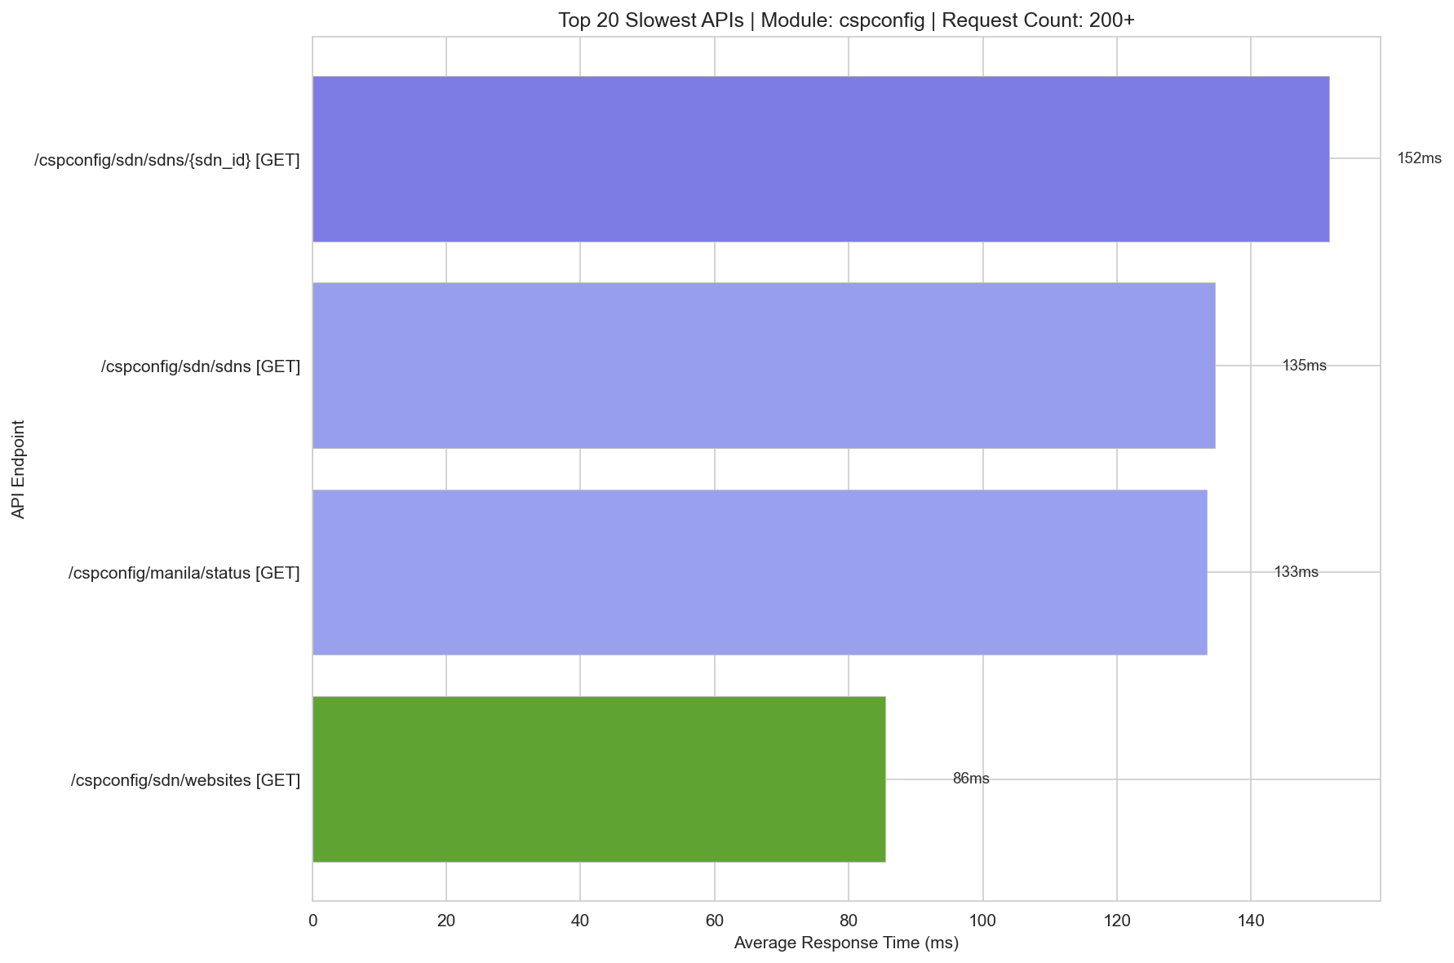
Slowest Cspconfig 200+

Slide 3
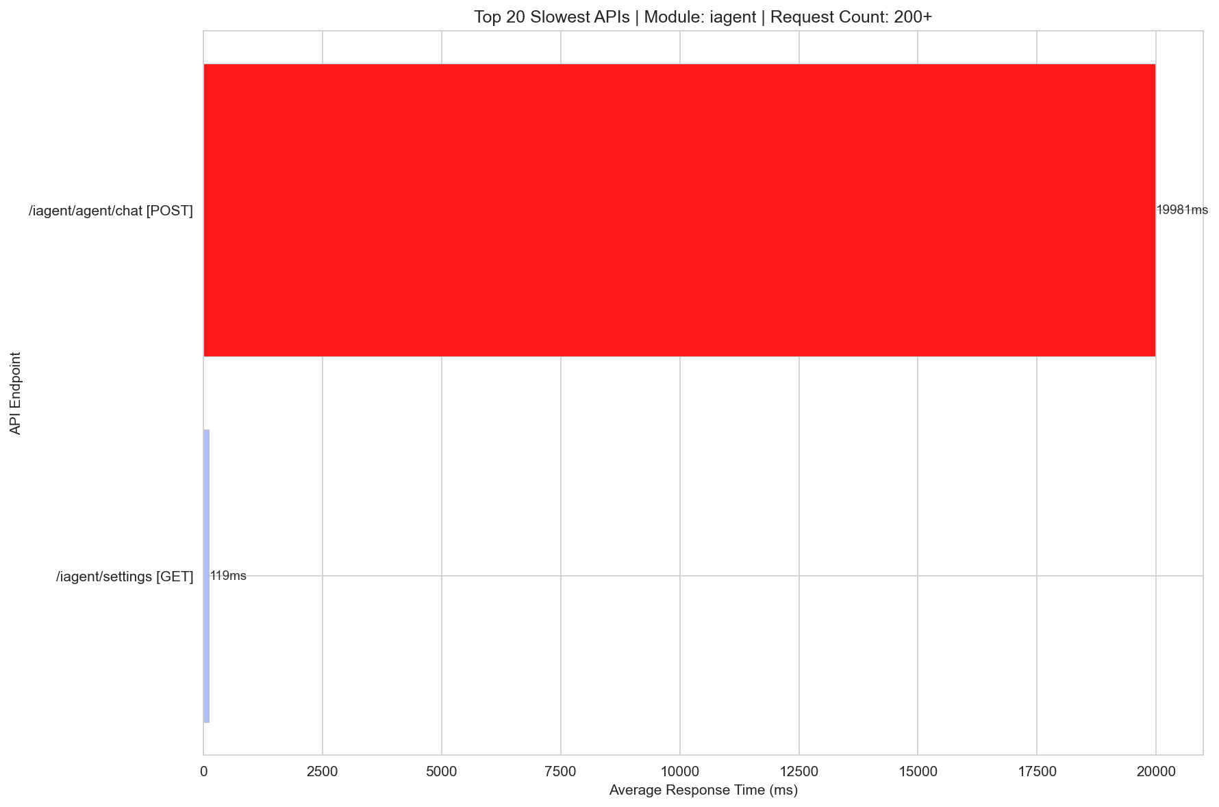
Slowest Iagent 200+

Slide 4
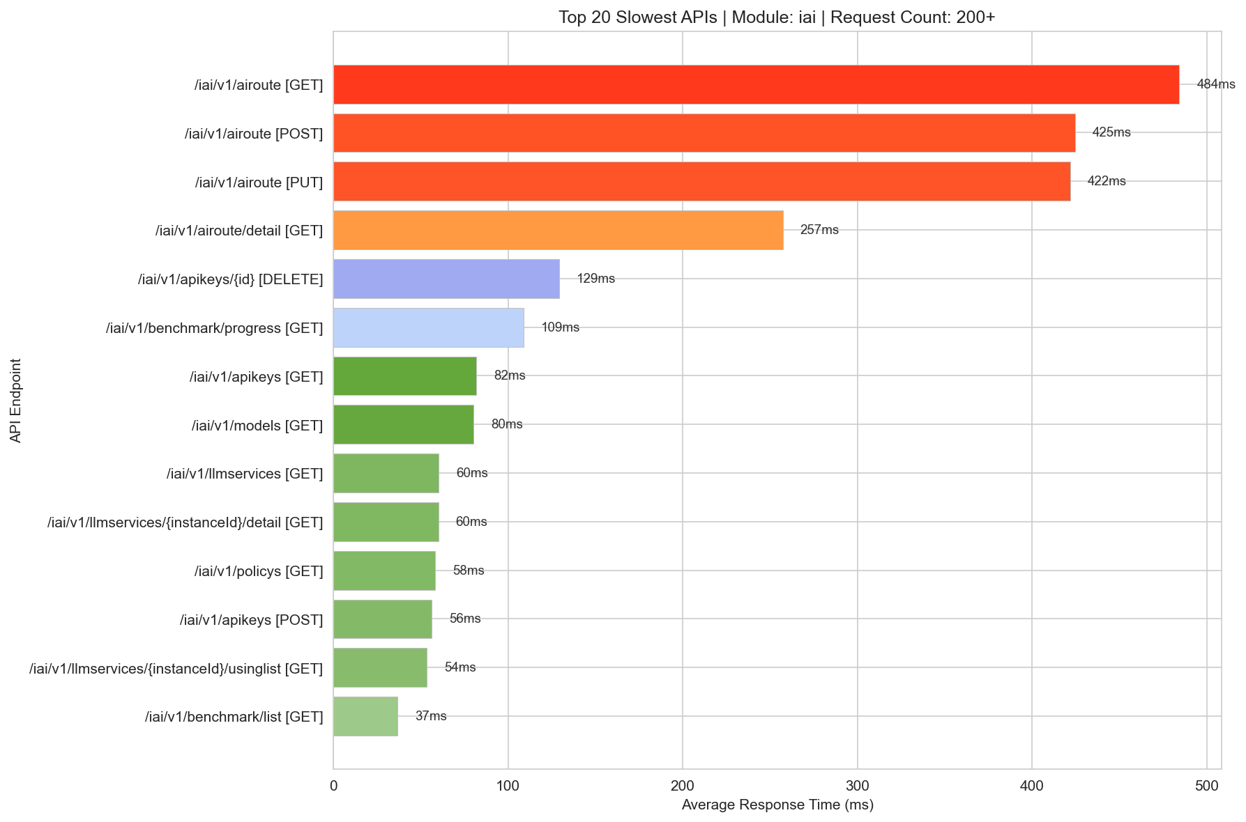
Slowest Iai 200+

Slide 5
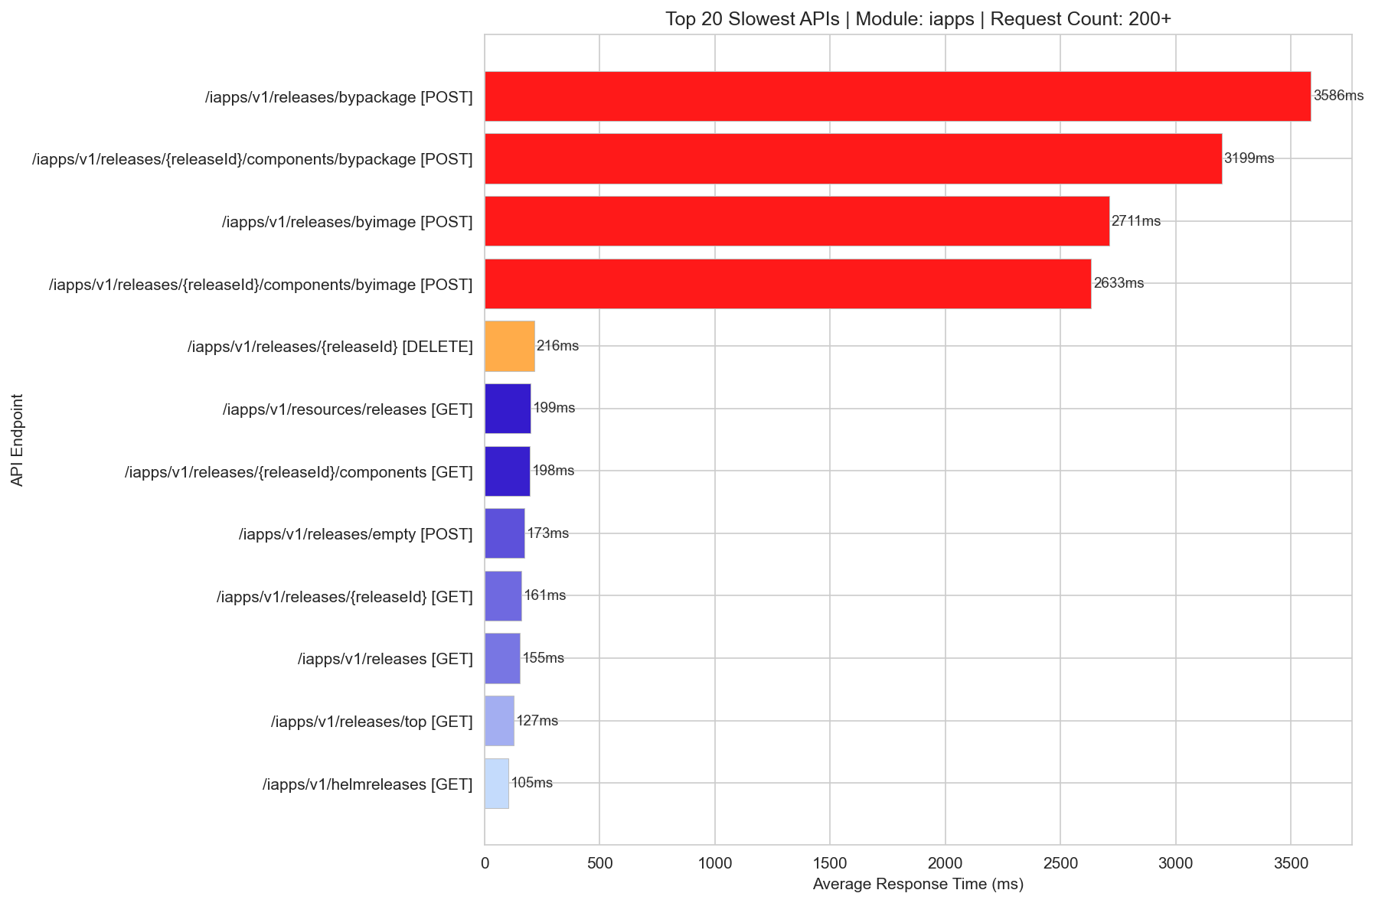
Slowest Iapps 200+

Slide 6
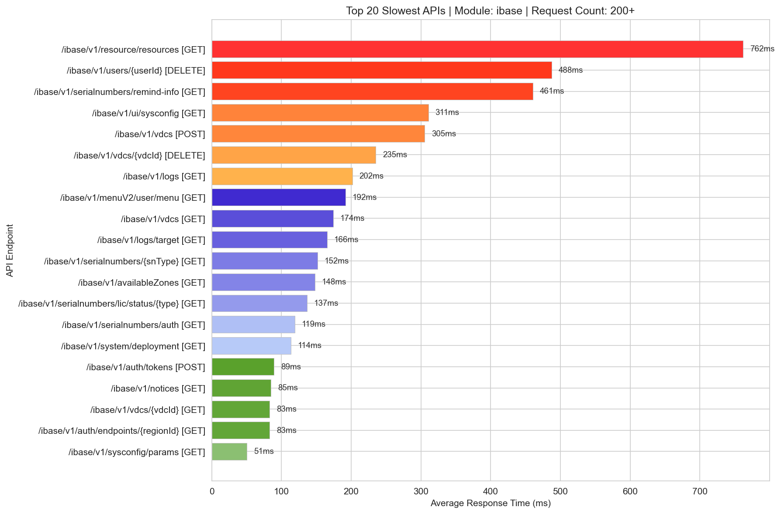
Slowest Ibase 200+

Slide 7
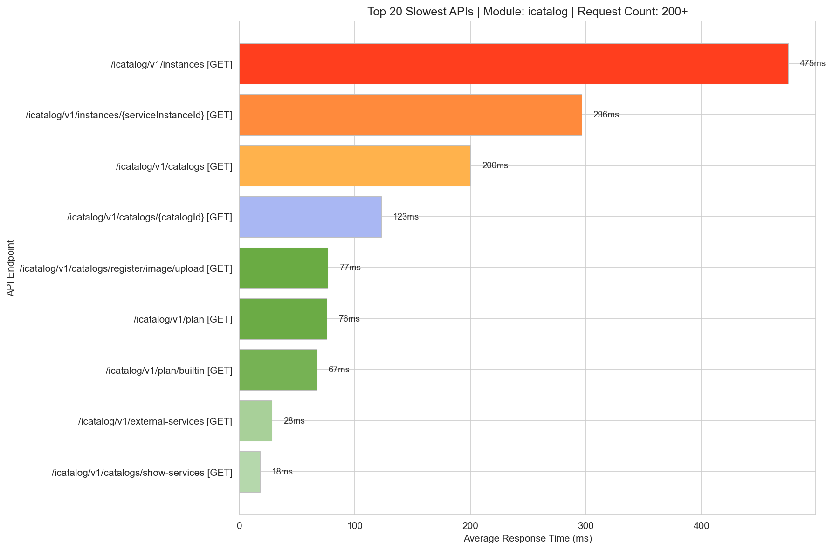
Slowest Icatalog 200+

Slide 8
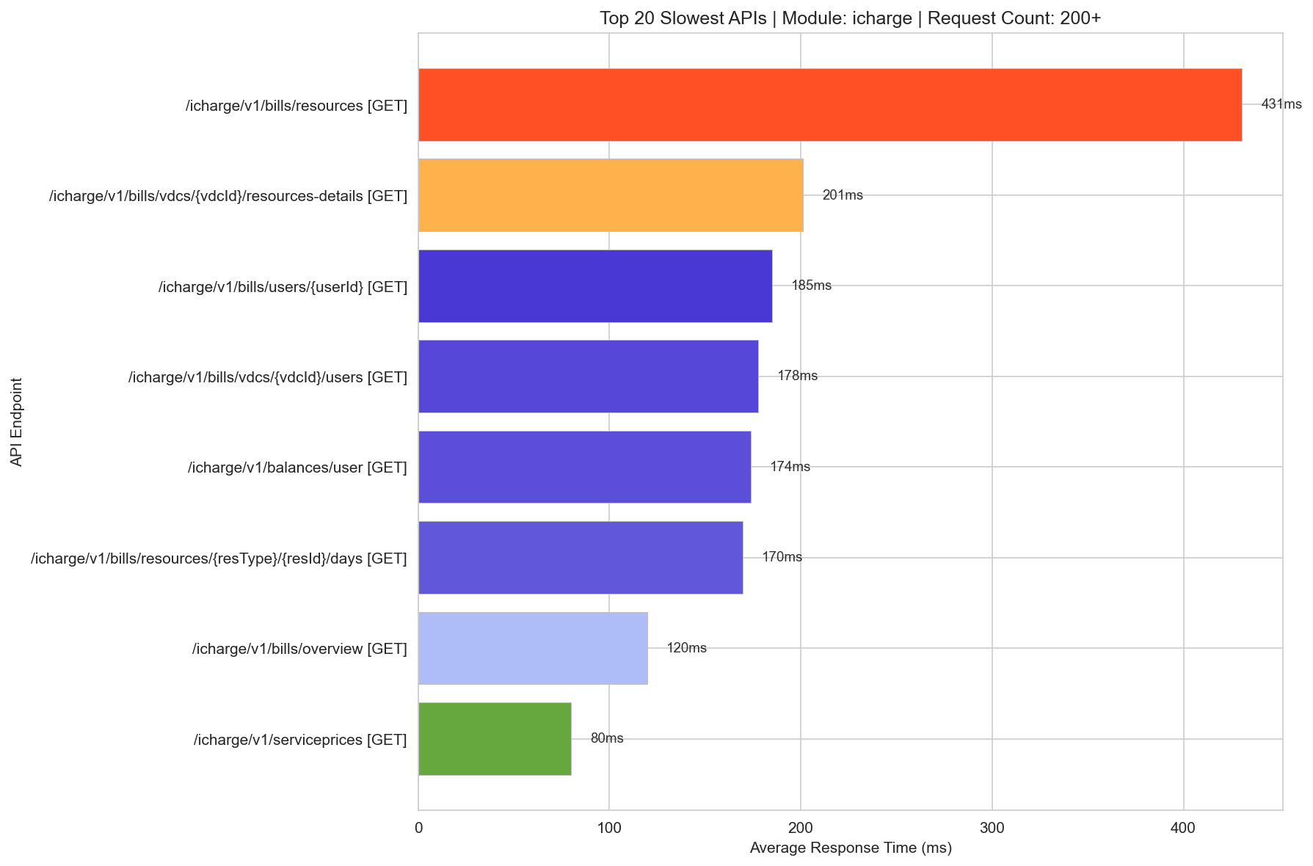
Slowest Icharge 200+

Slide 9
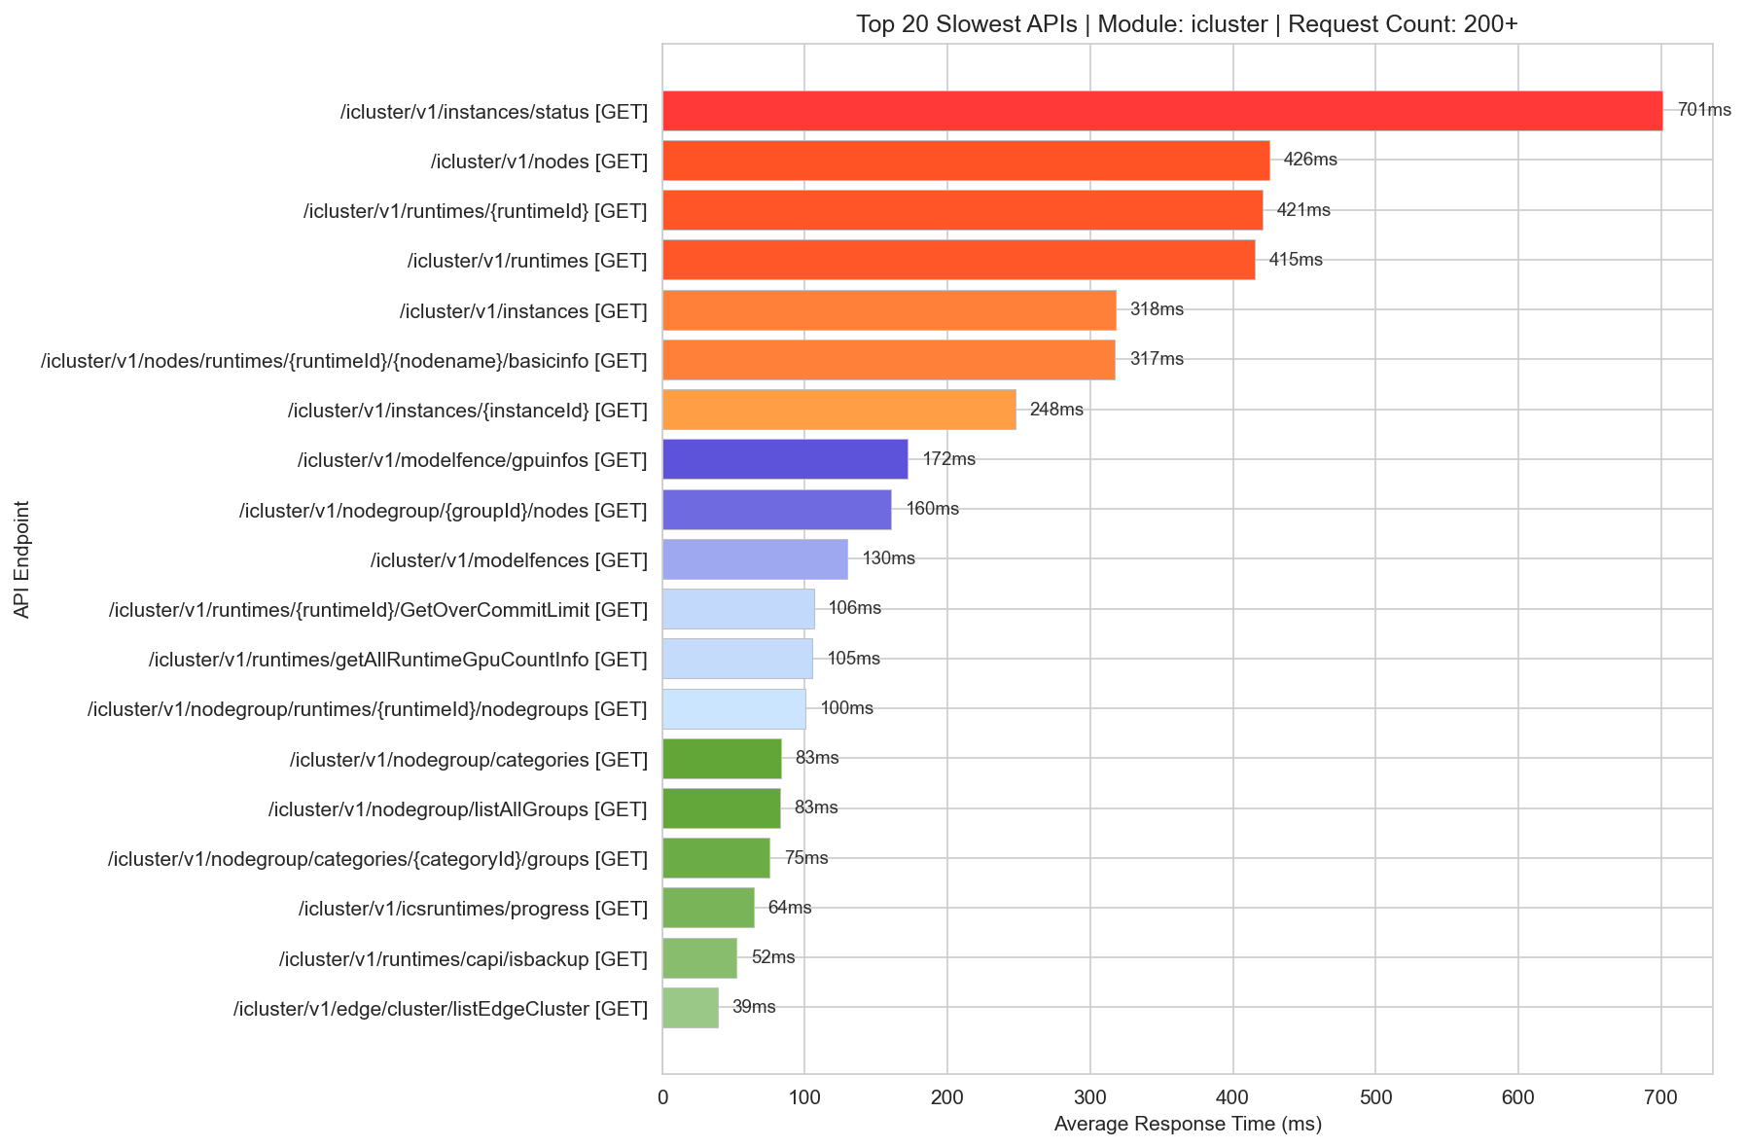
Slowest Icluster 200+

Slide 10
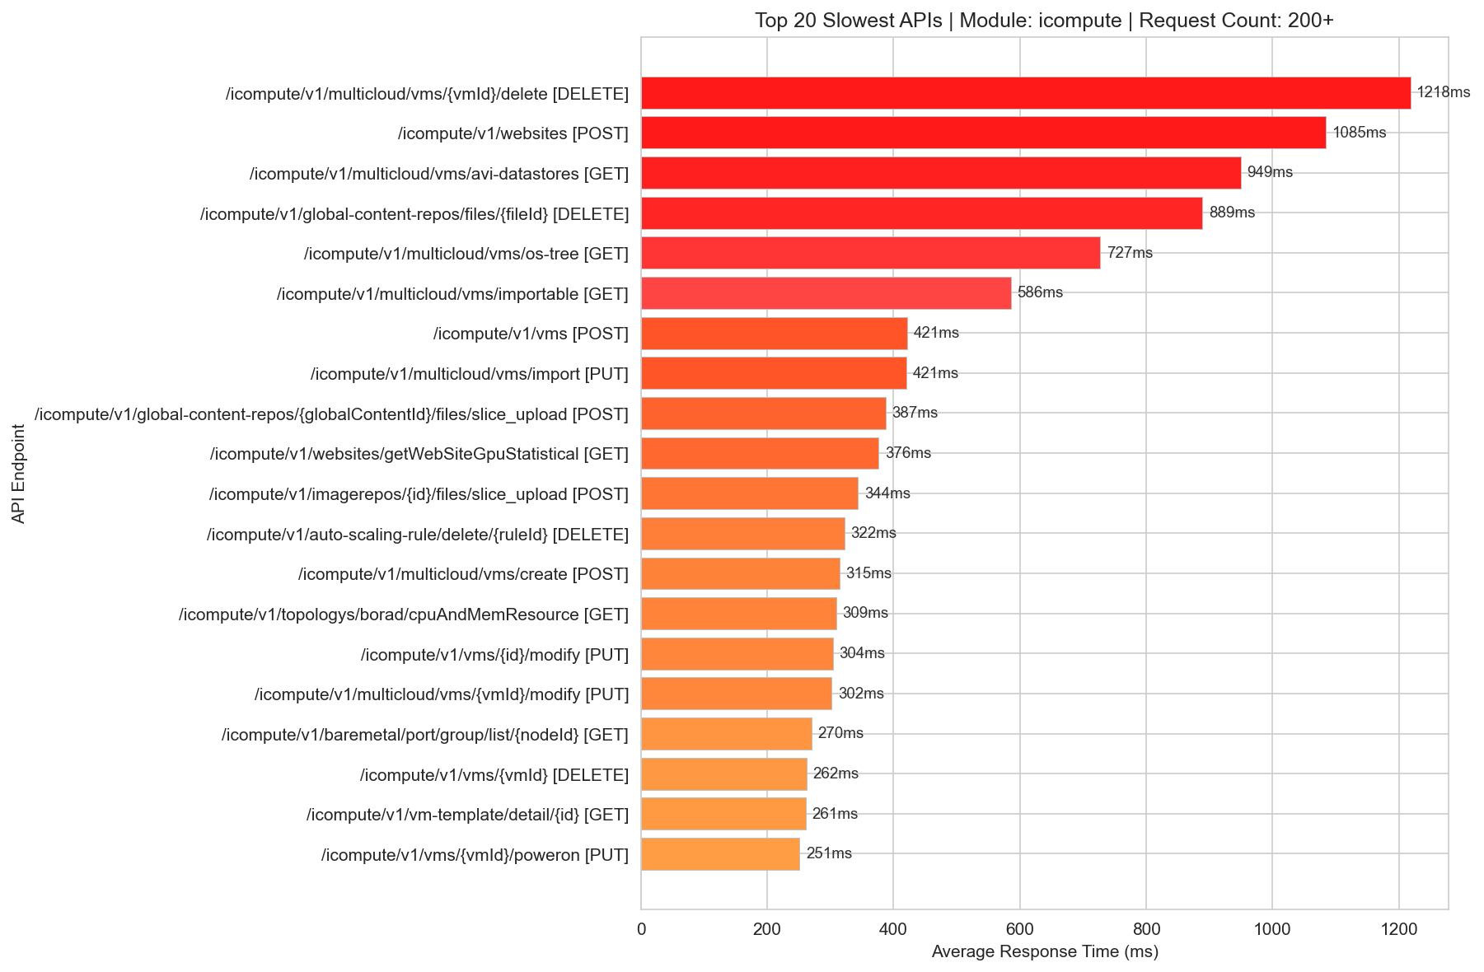
Slowest Icompute 200+

Slide 11
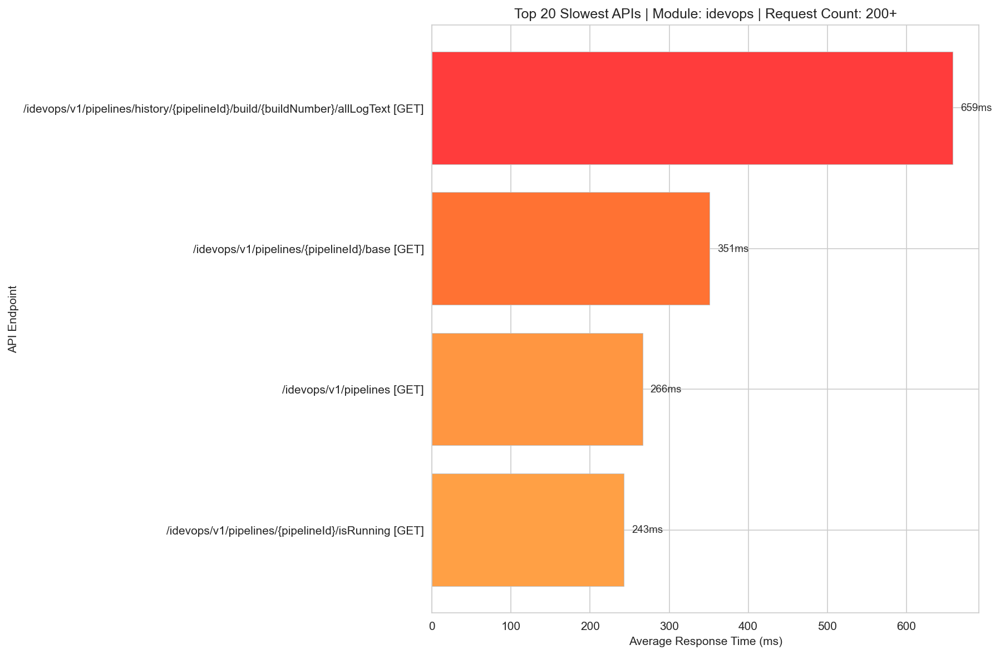
Slowest Idevops 200+

Slide 12
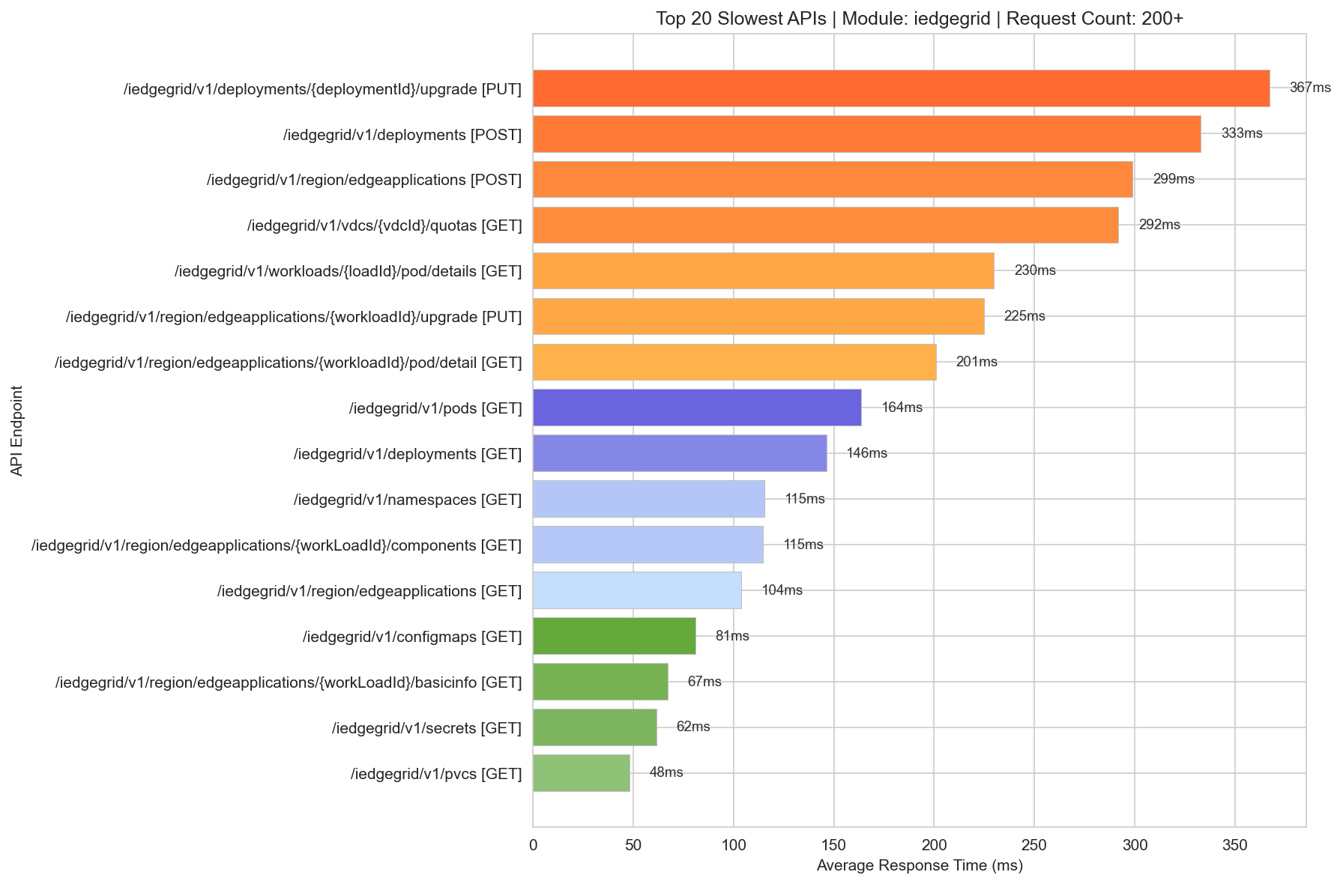
Slowest Iedgegrid 200+

Slide 13
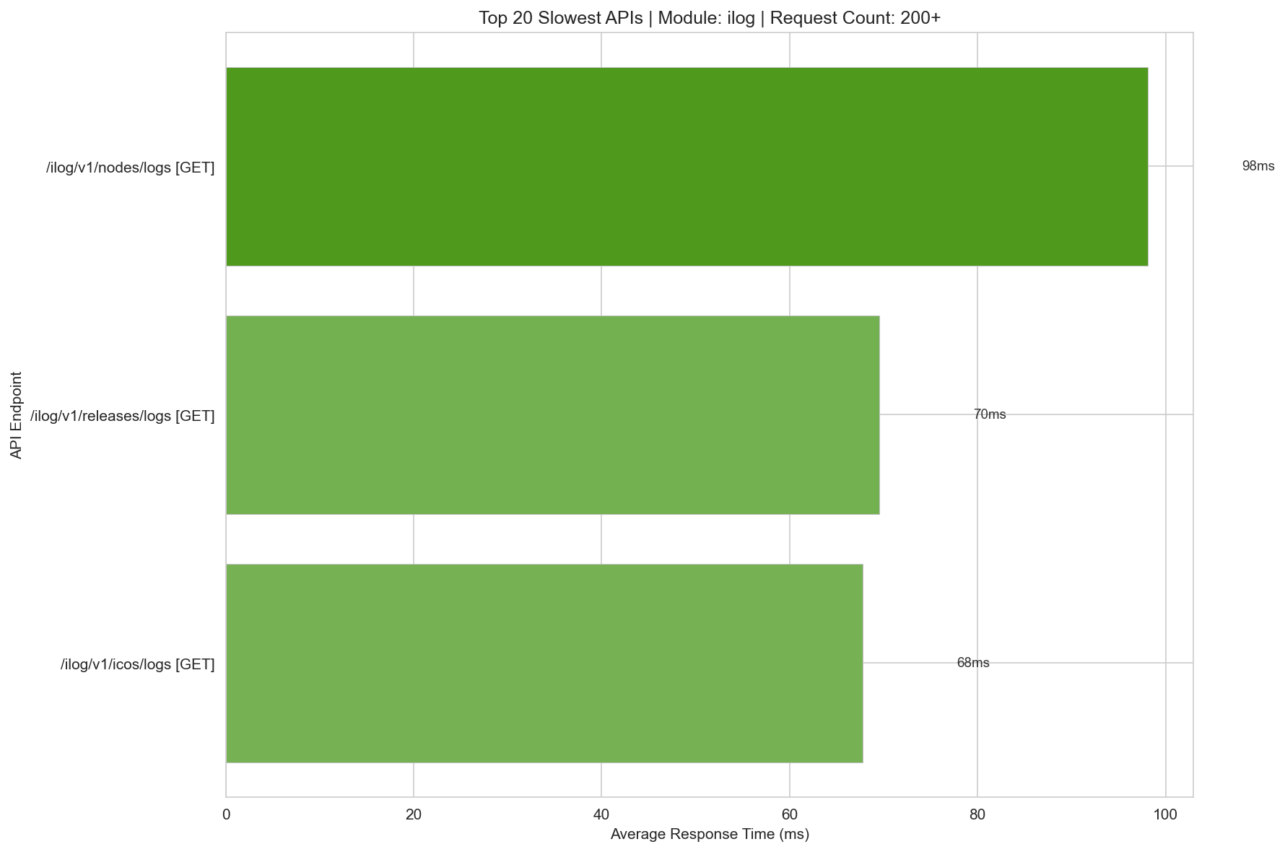
Slowest Ilog 200+

Slide 14
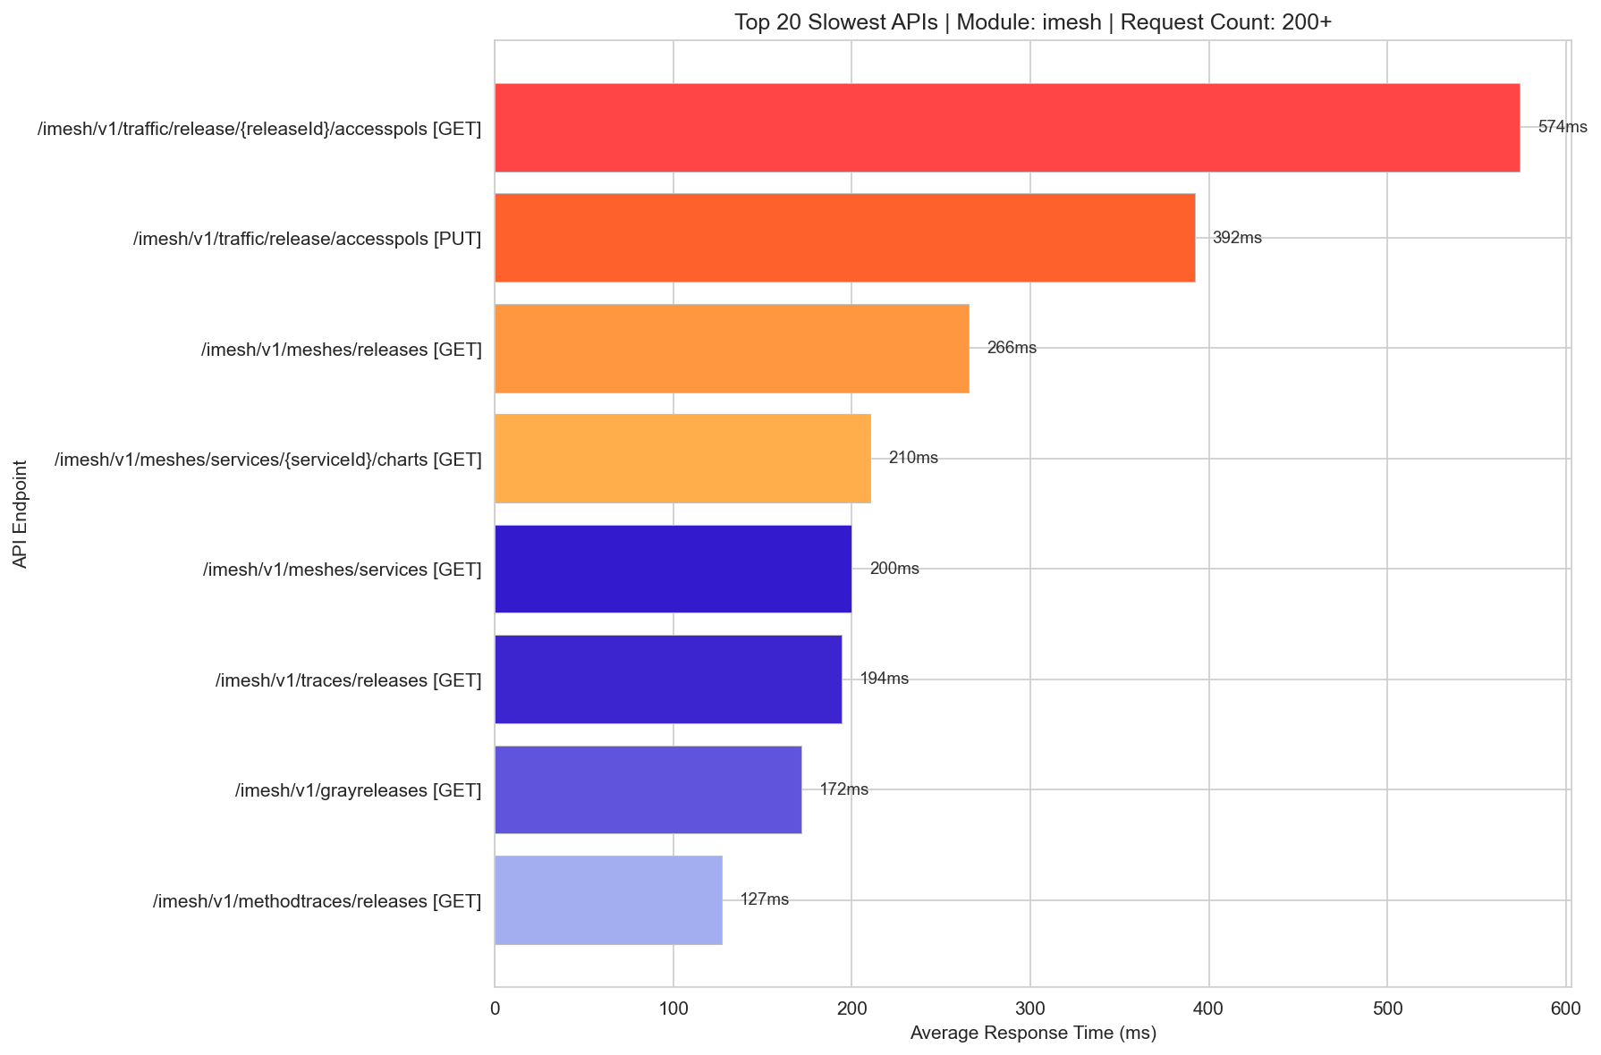
Slowest Imesh 200+

Slide 15
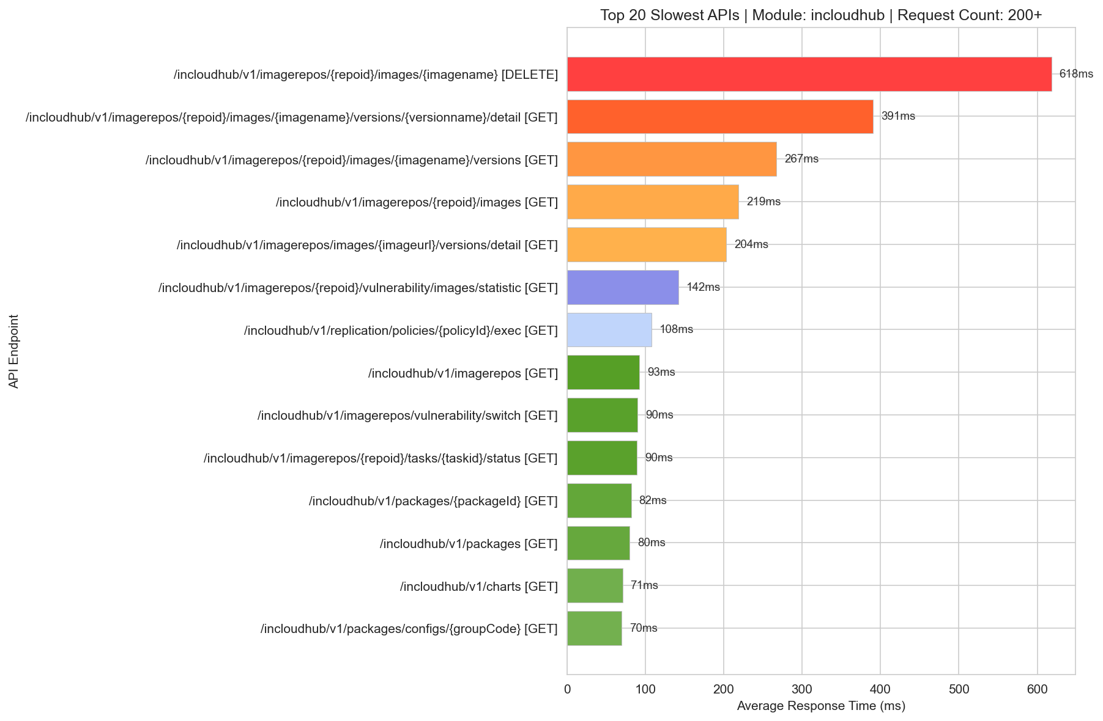
Slowest Incloudhub 200+

Slide 16
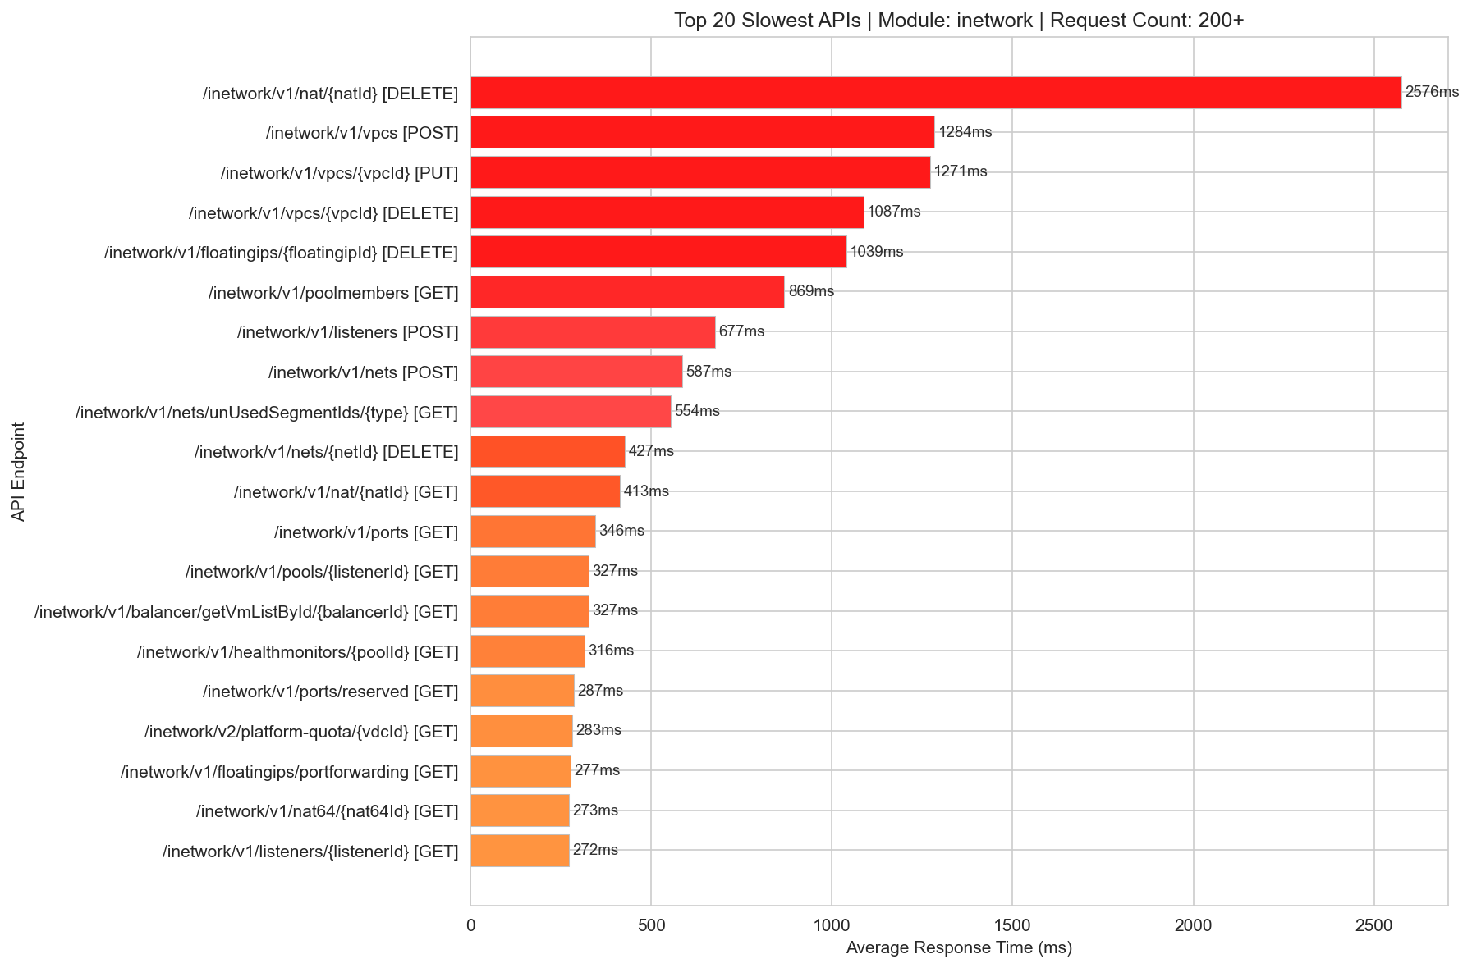
Slowest Inetwork 200+

Slide 17
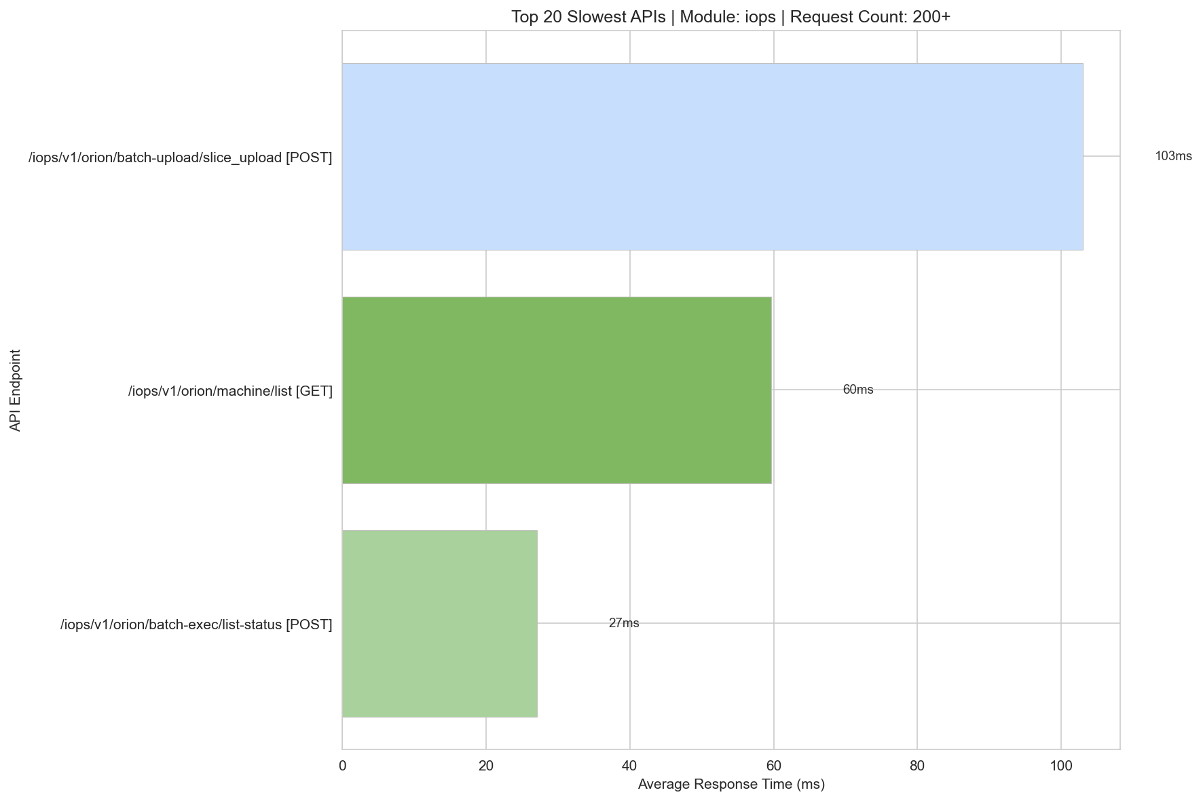
Slowest Iops 200+

Slide 18
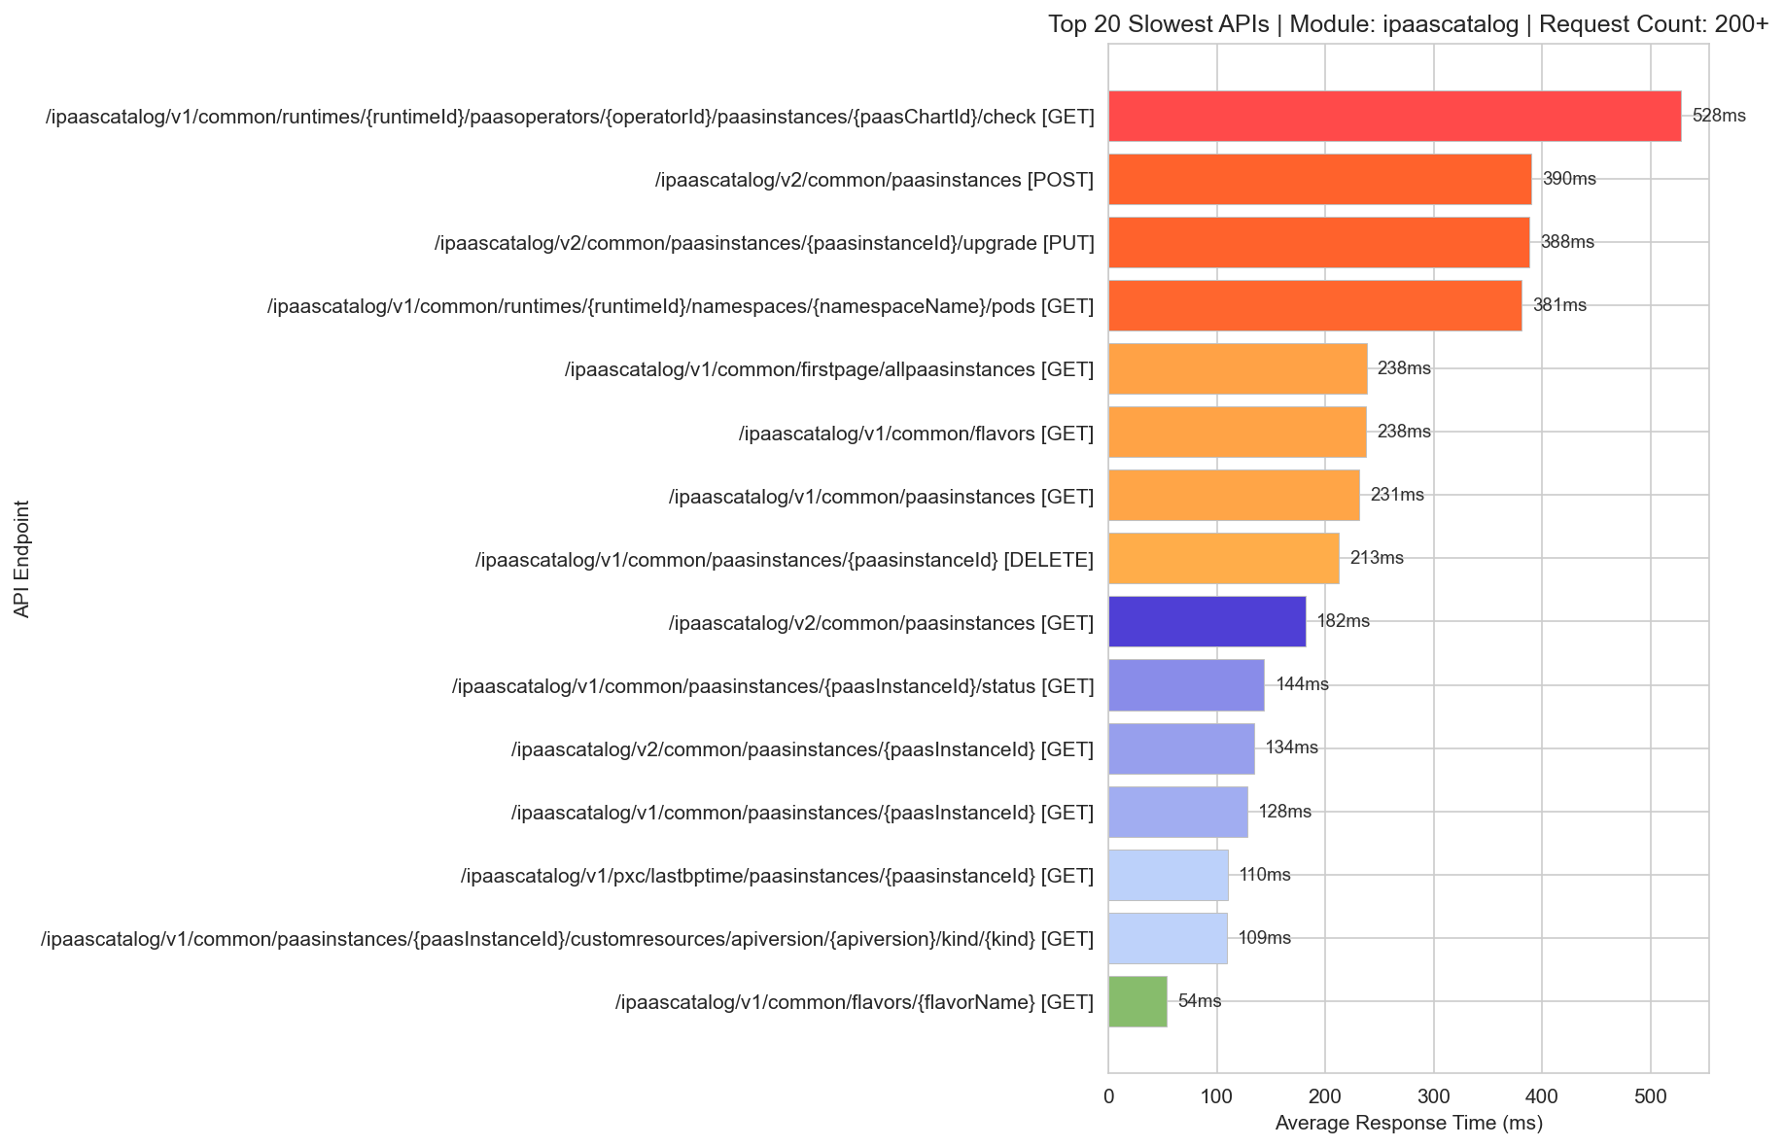
Slowest Ipaascatalog 200+

Slide 19
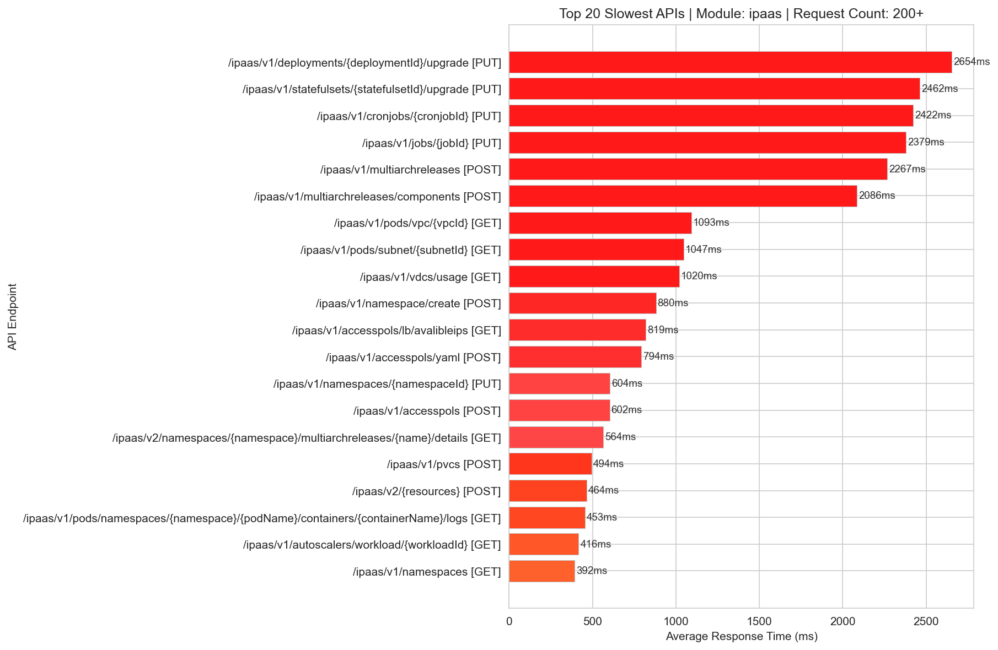
Slowest Ipaas 200+

Slide 20
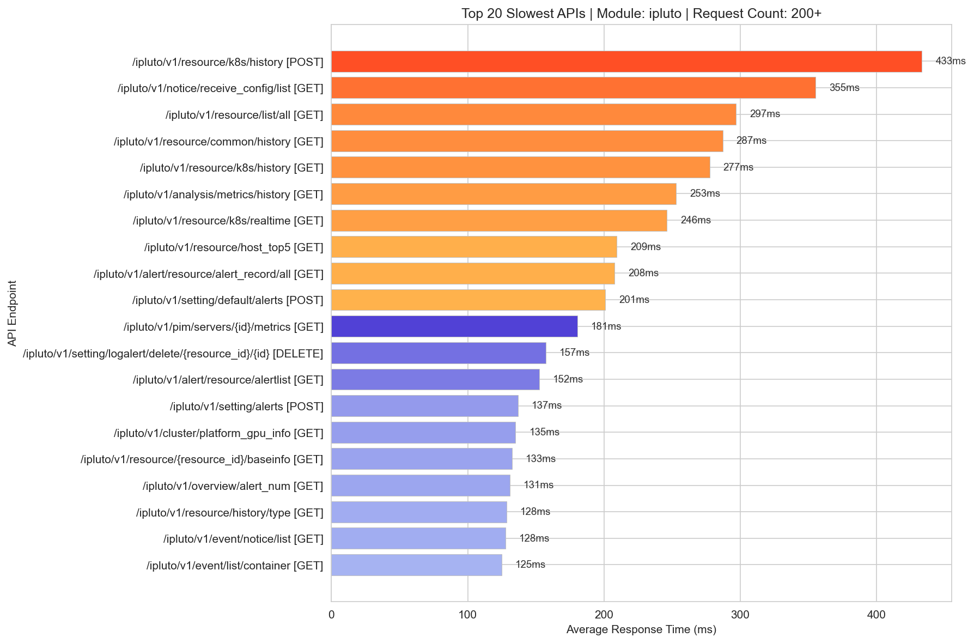
Slowest Ipluto 200+

Slide 21
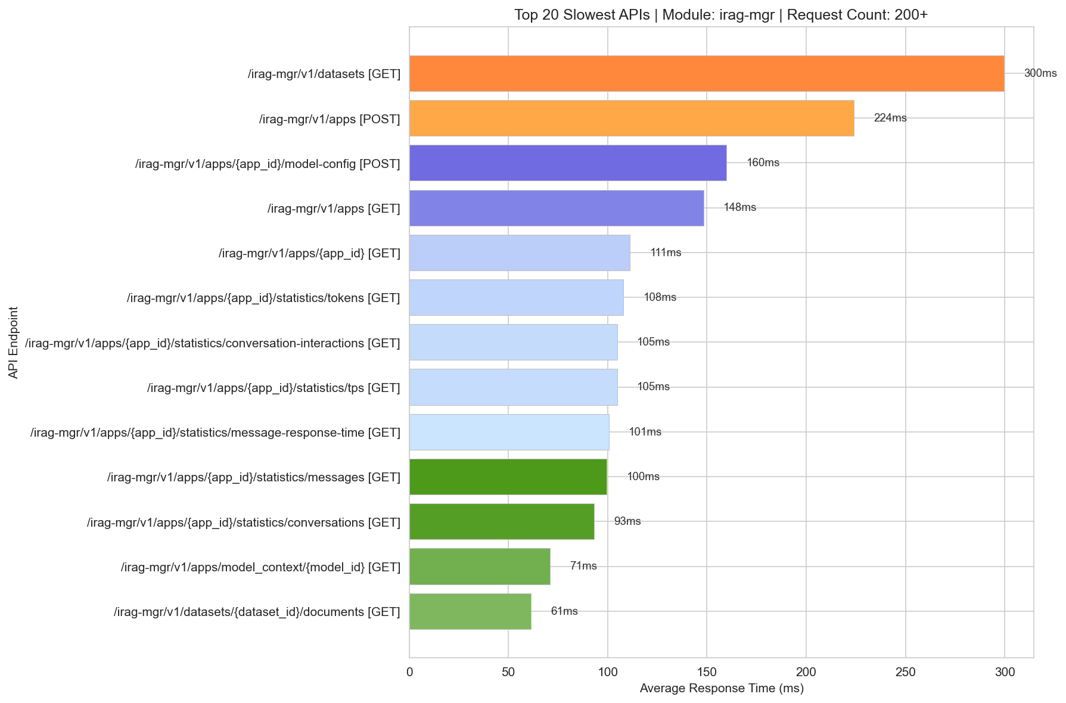
Slowest Irag-Mgr 200+

Slide 22
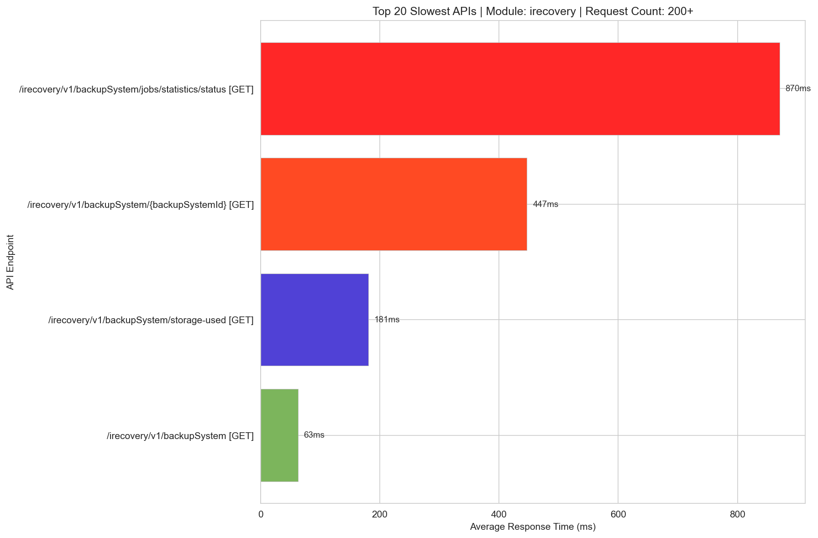
Slowest Irecovery 200+

Slide 23
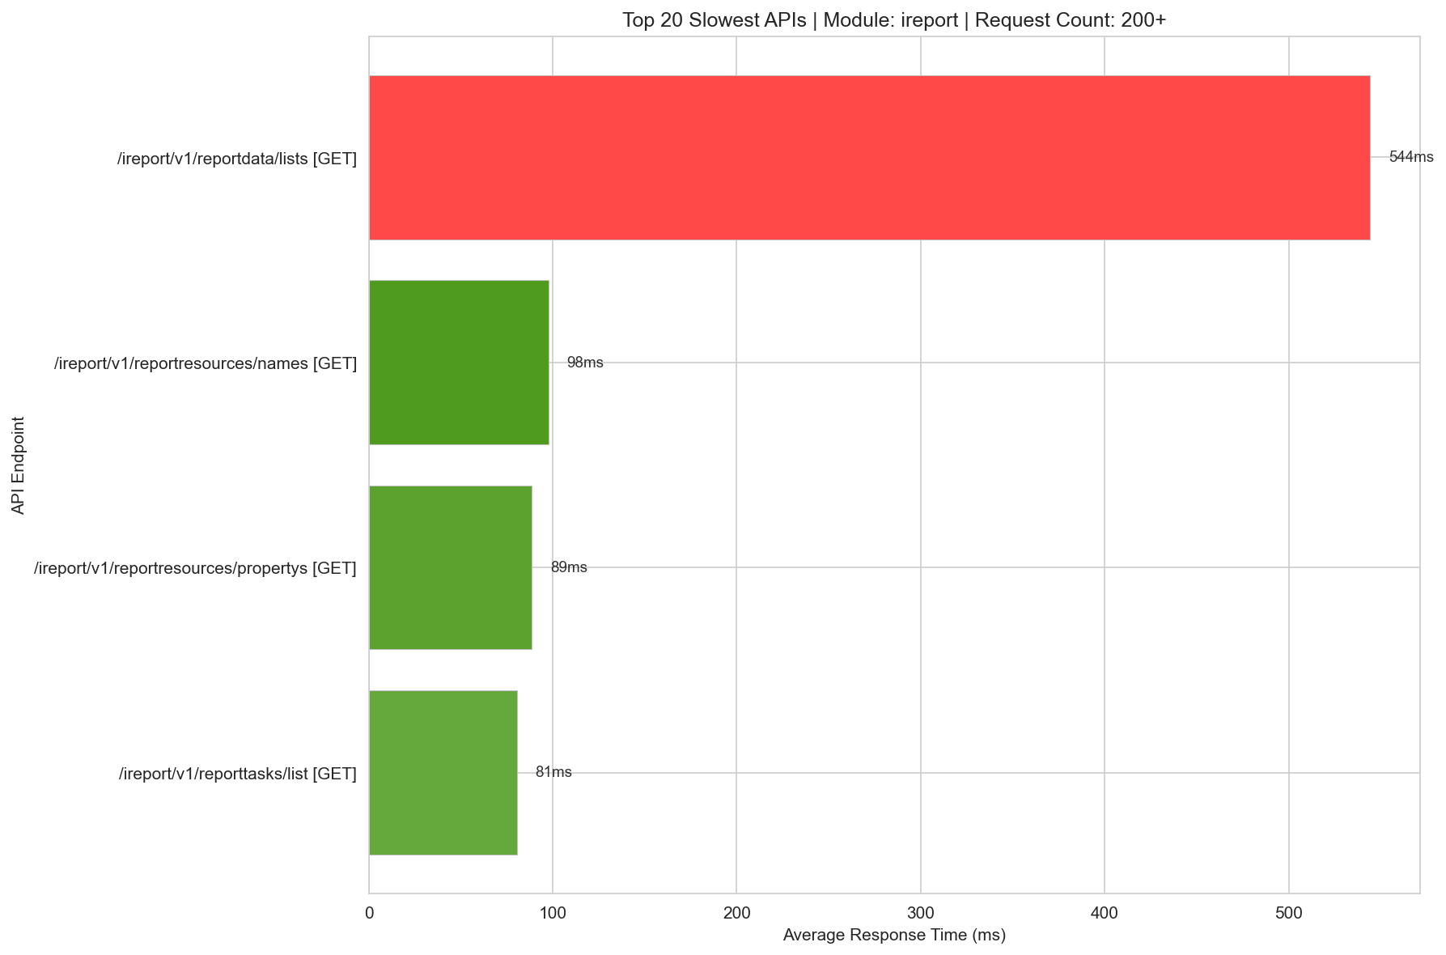
Slowest Ireport 200+

Slide 24
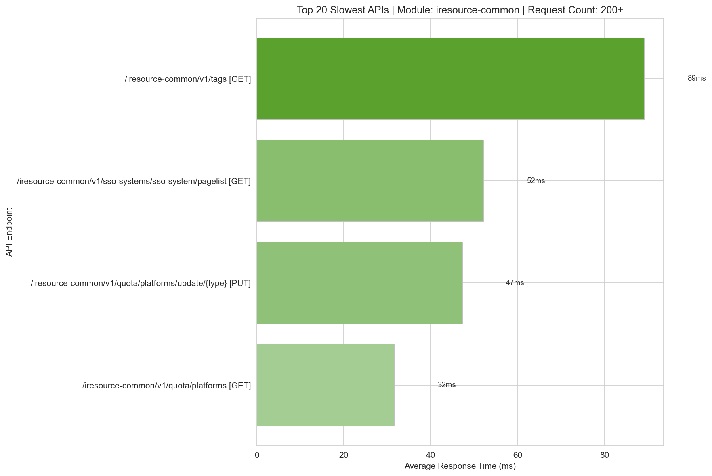
Slowest Iresource-Common 200+

Slide 25
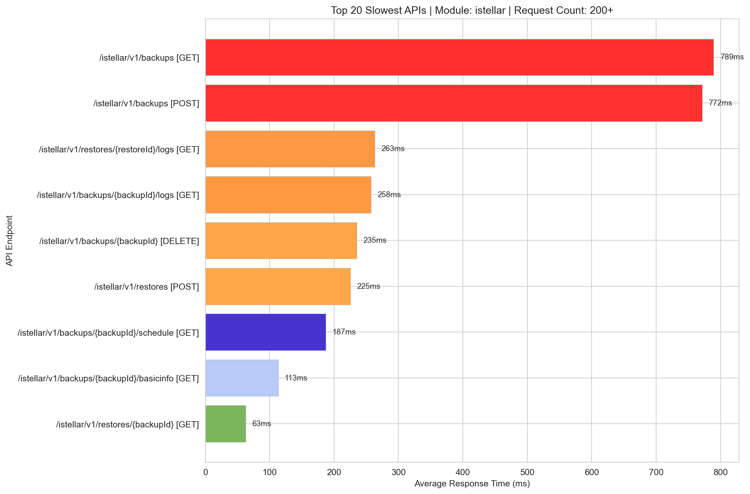
Slowest Istellar 200+

Slide 26
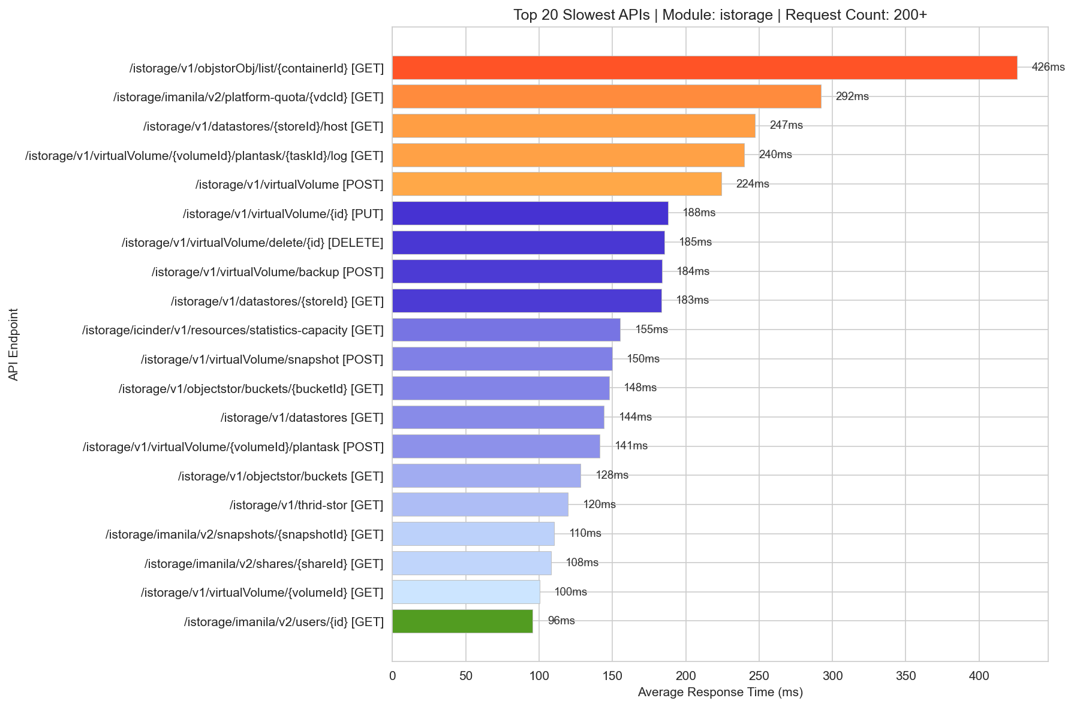
Slowest Istorage 200+

Slide 27
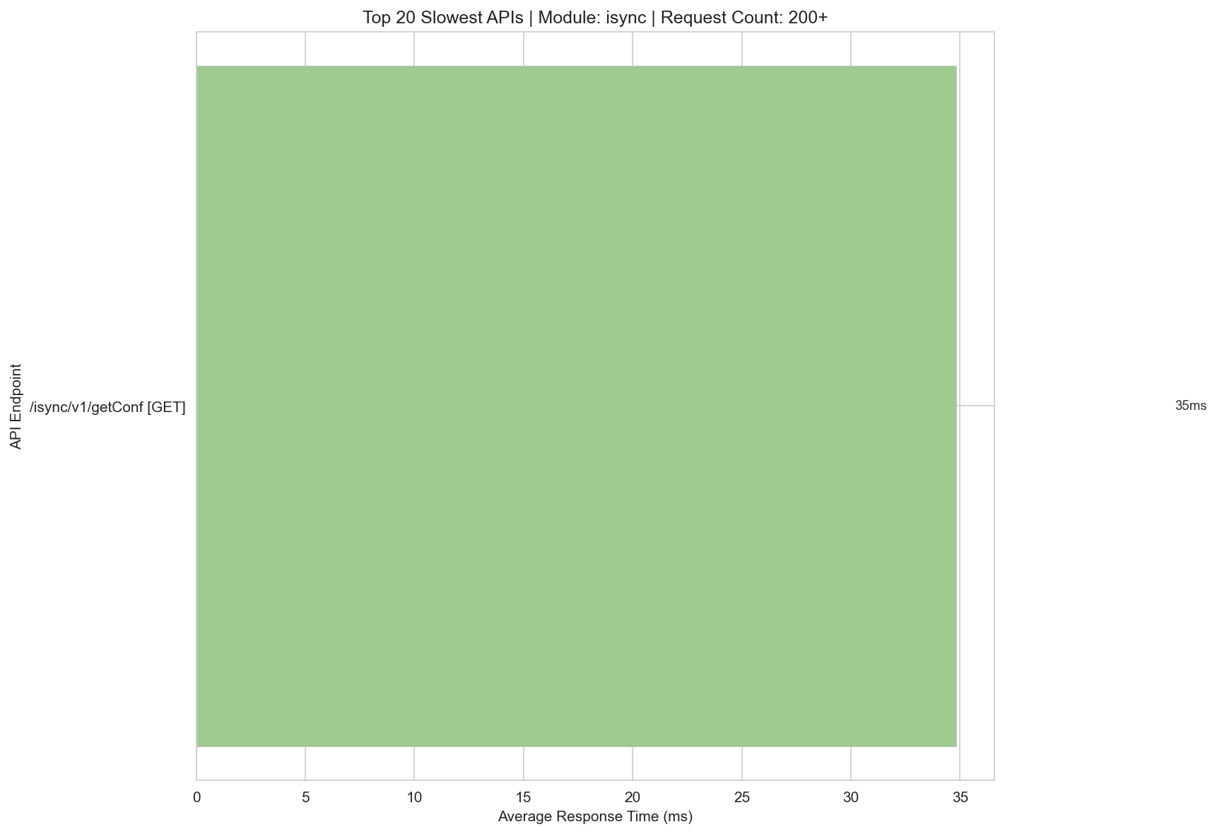
Slowest Isync 200+

Slide 28
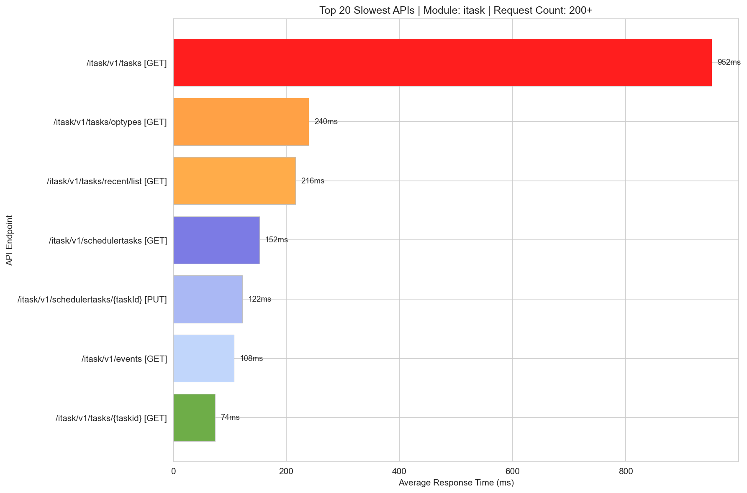
Slowest Itask 200+

Slide 29
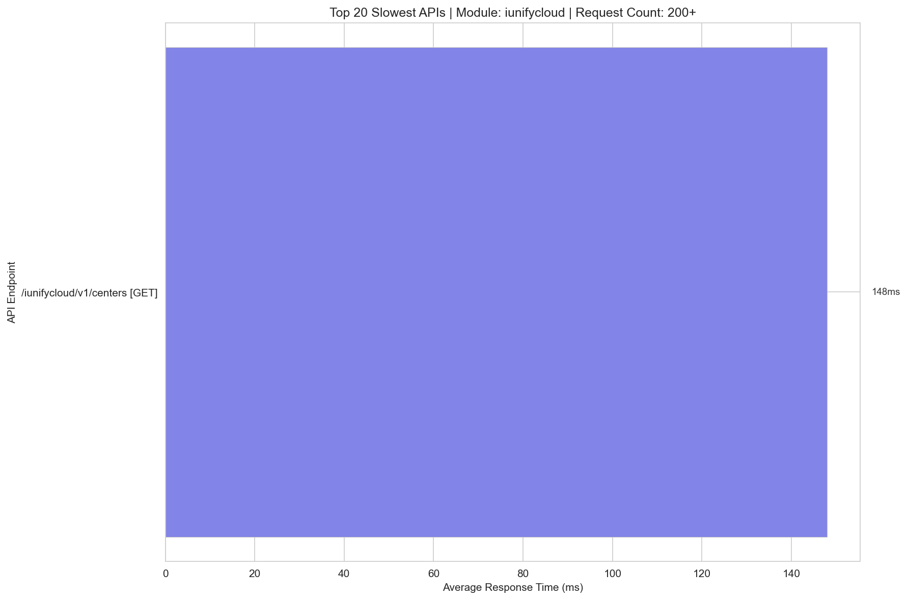
Slowest Iunifycloud 200+

Slide 30
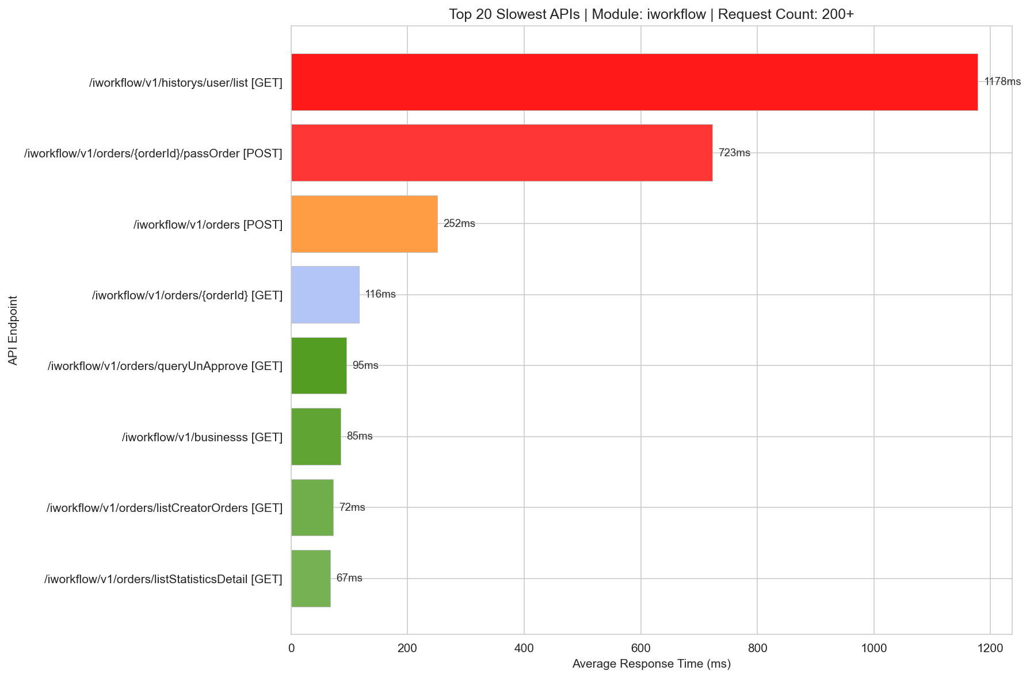
Slowest Iworkflow 200+

Slide 31
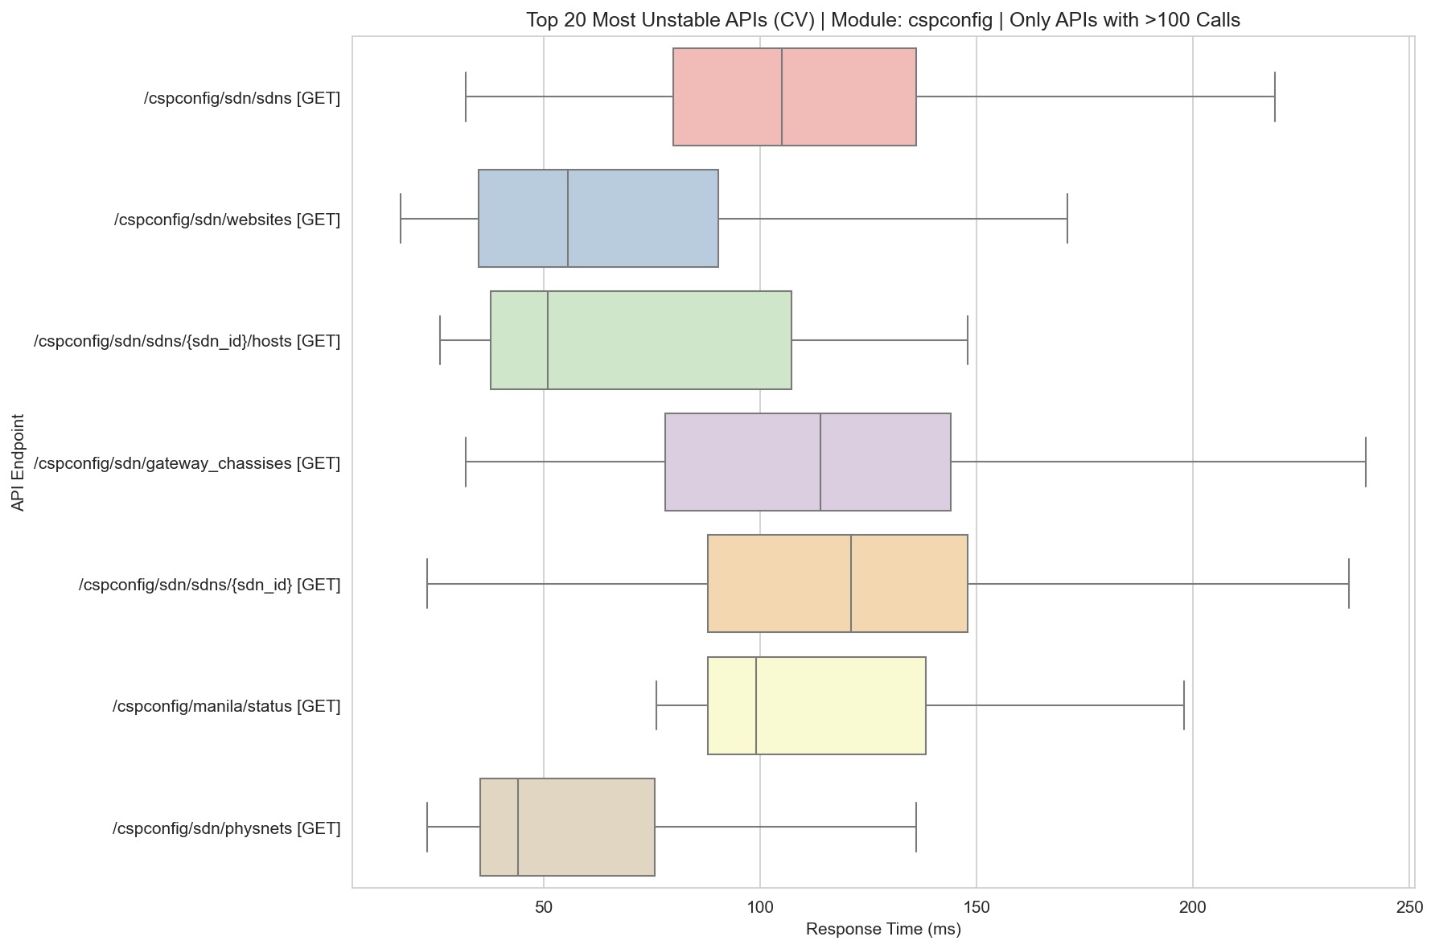
Unstable Boxplot Cspconfig

Slide 32
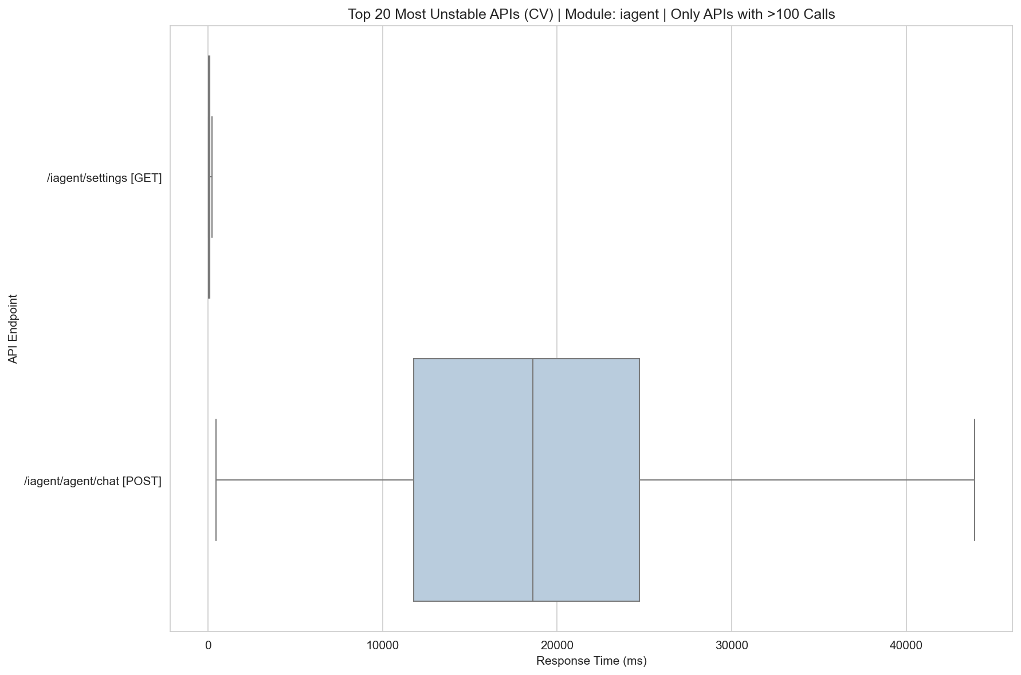
Unstable Boxplot Iagent

Slide 33
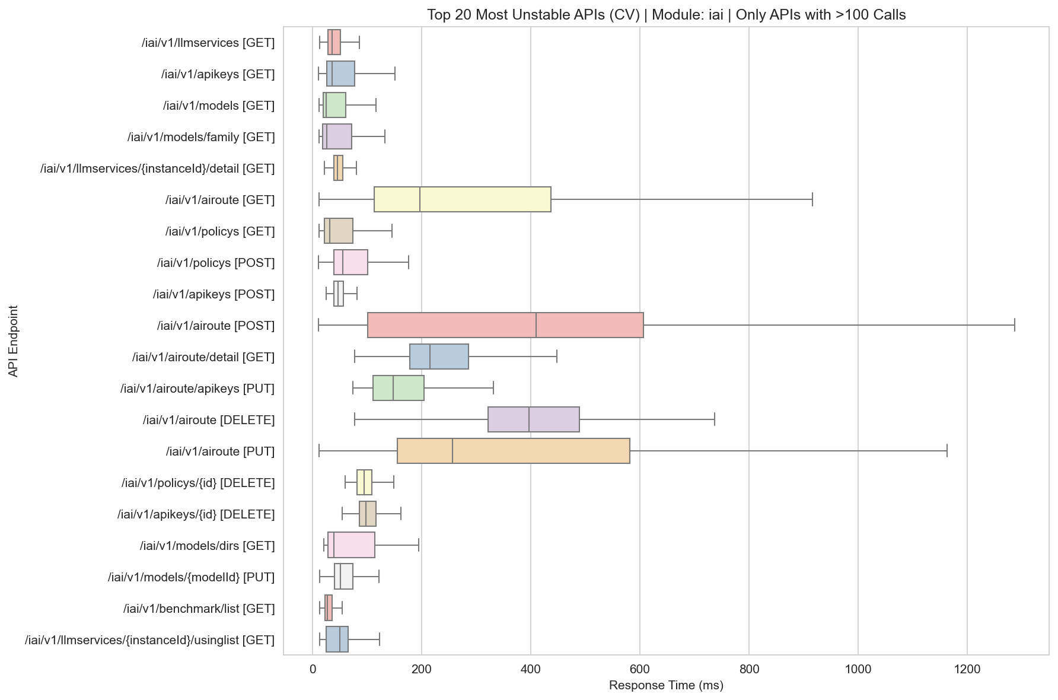
Unstable Boxplot Iai

Slide 34
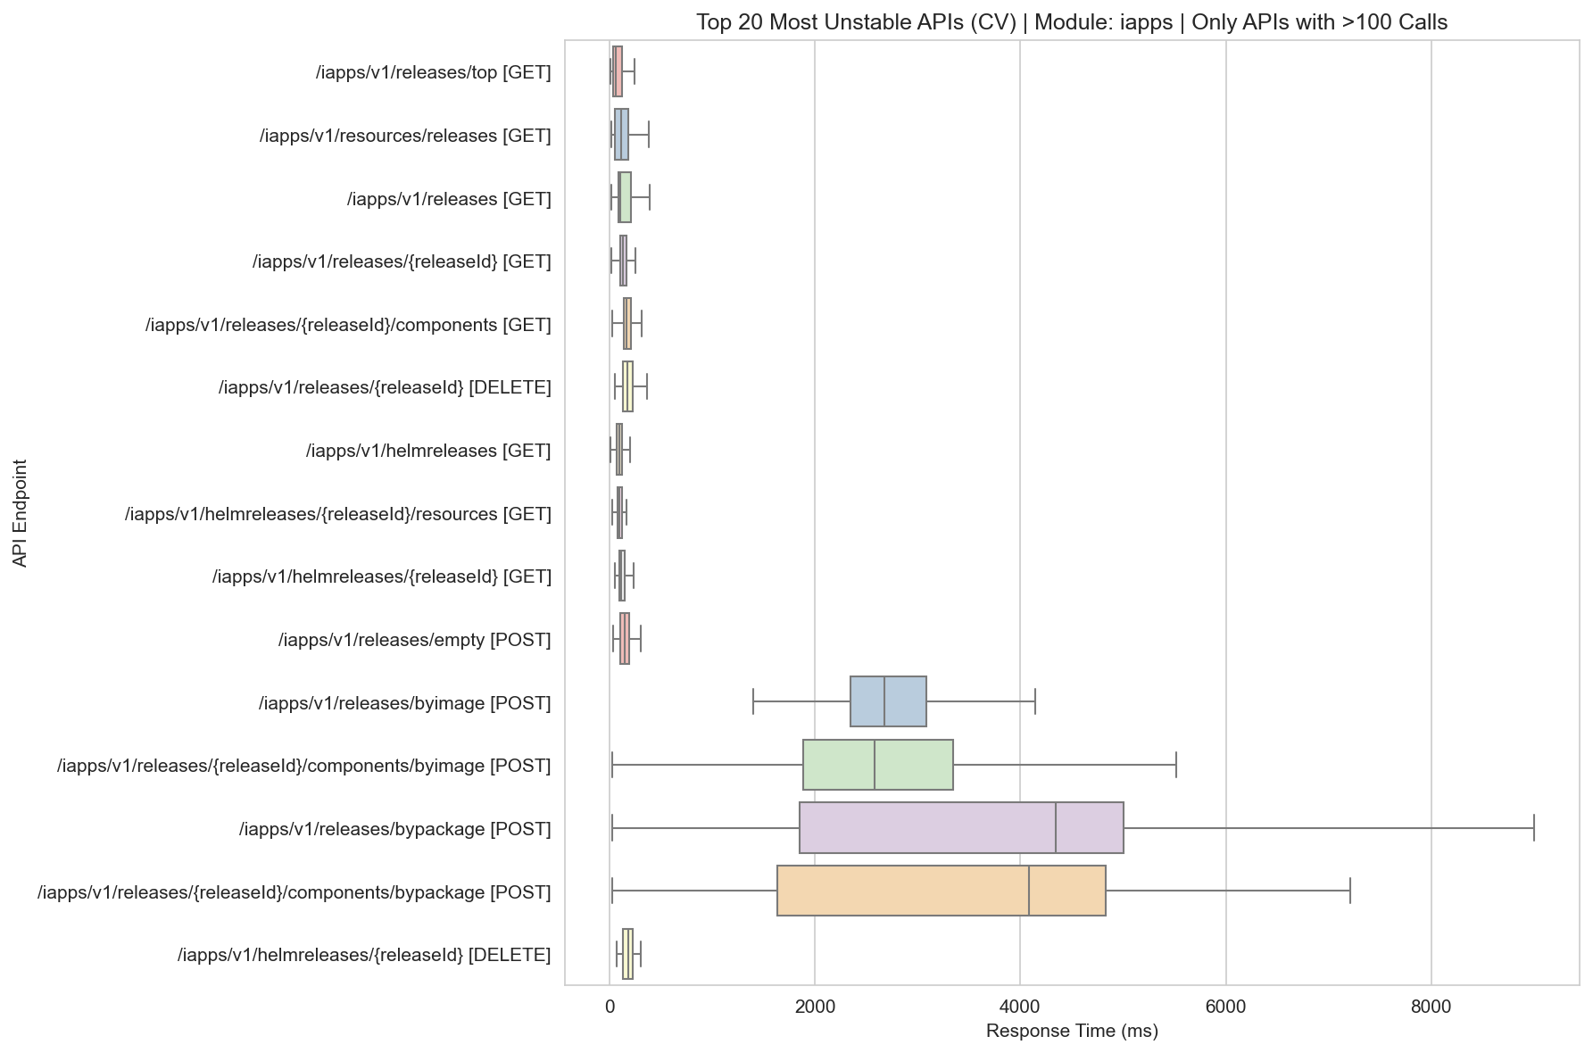
Unstable Boxplot Iapps

Slide 35
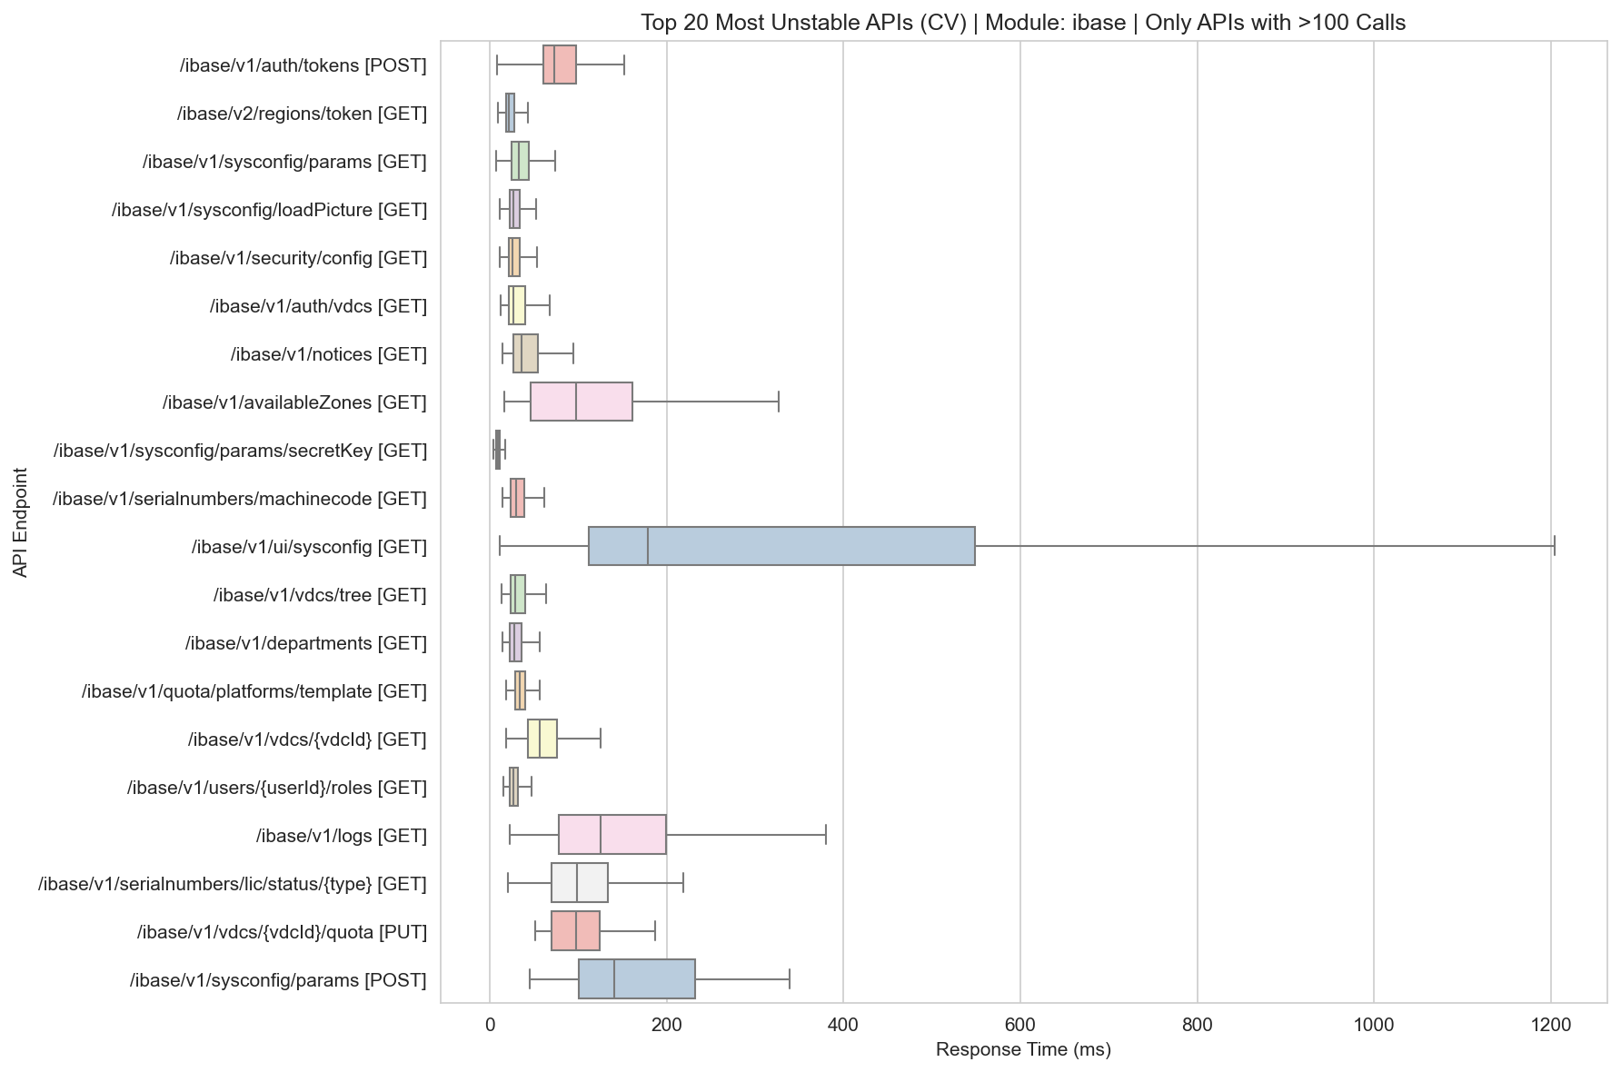
Unstable Boxplot Ibase

Slide 36
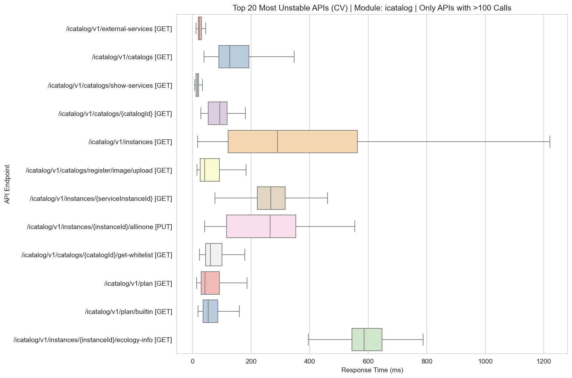
Unstable Boxplot Icatalog

Slide 37
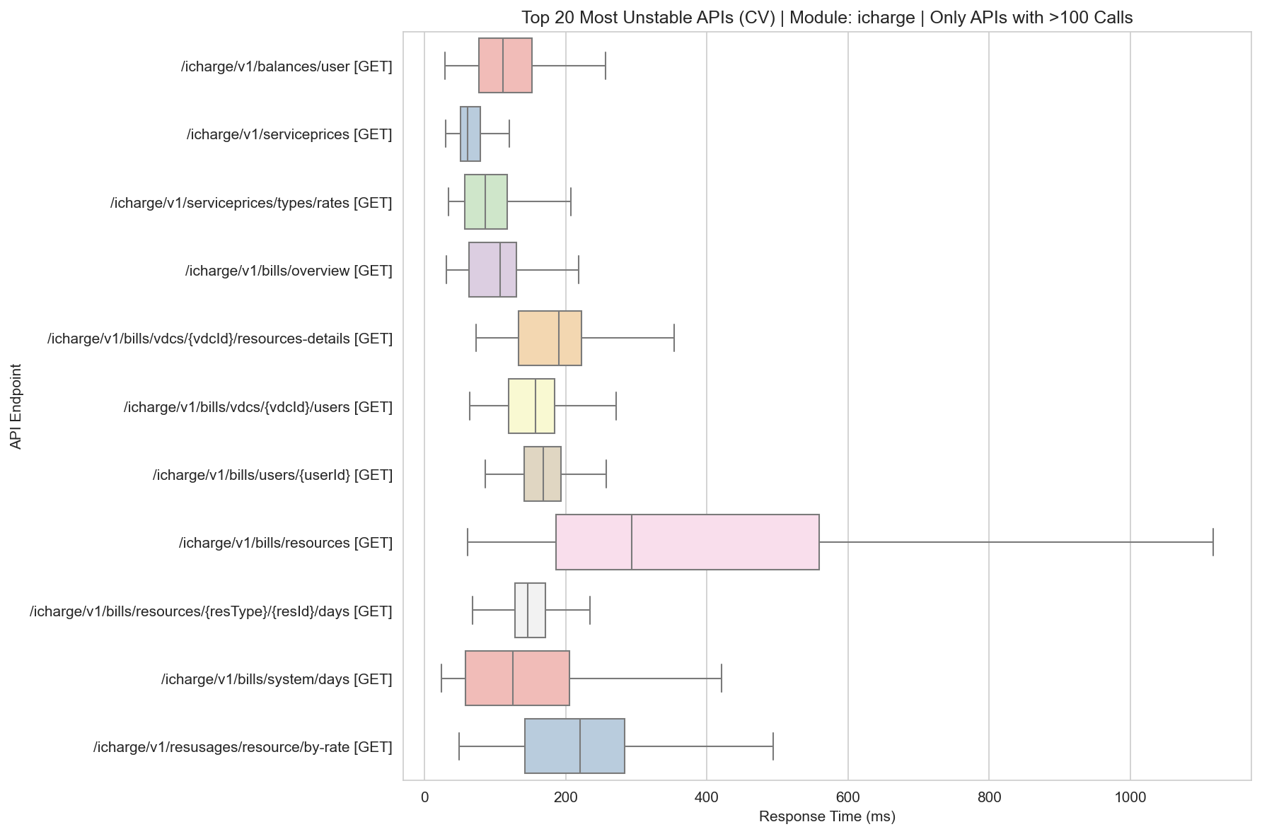
Unstable Boxplot Icharge

Slide 38
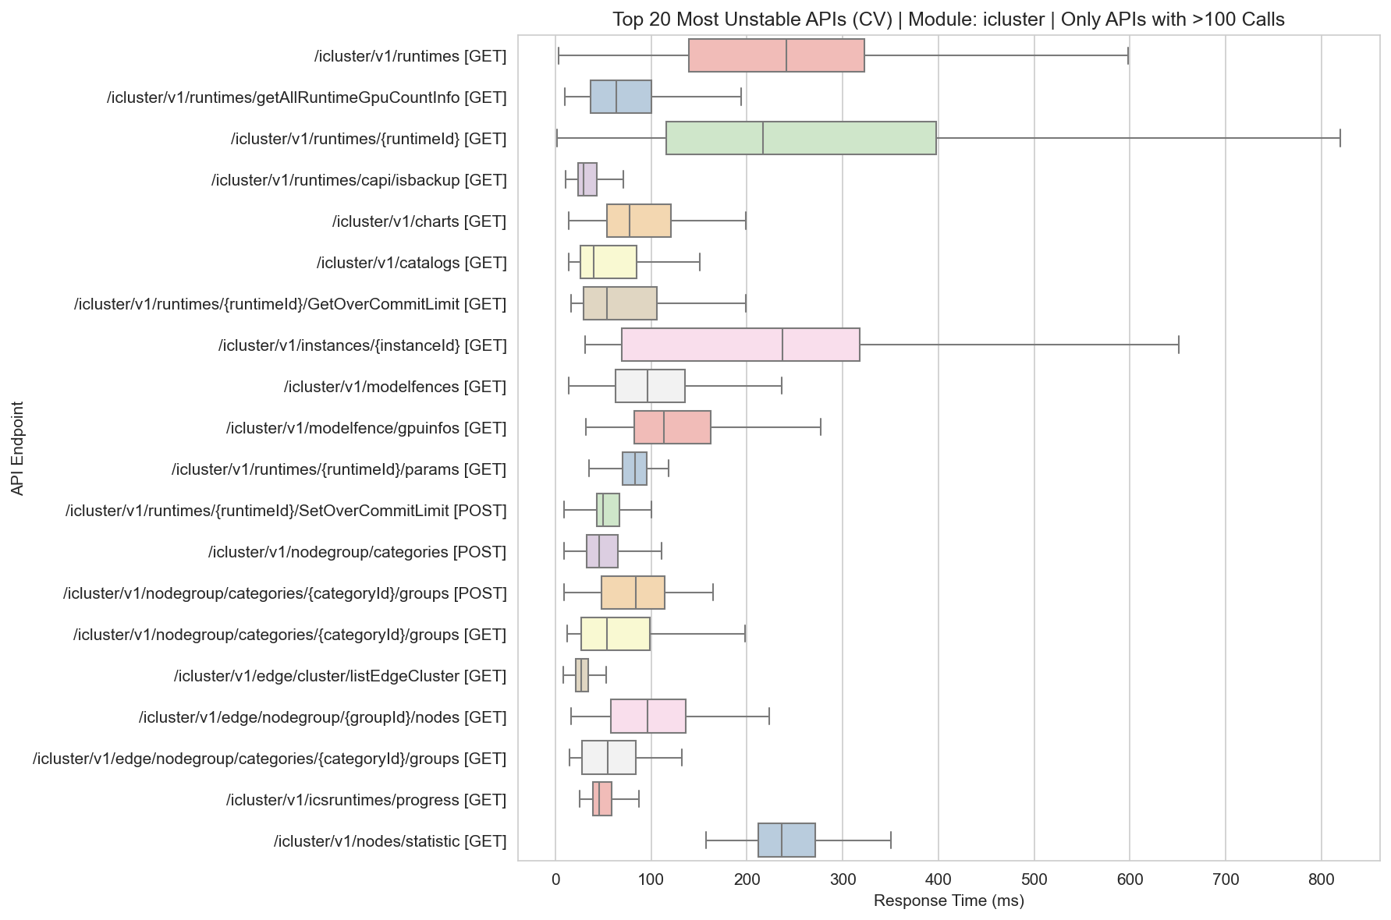
Unstable Boxplot Icluster

Slide 39
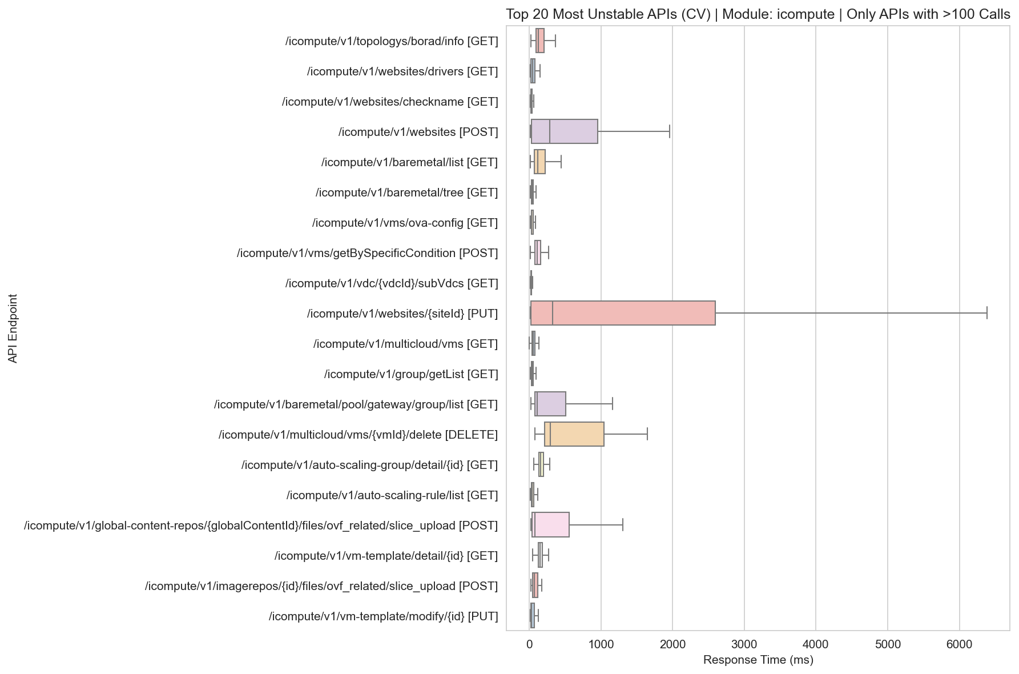
Unstable Boxplot Icompute

Slide 40
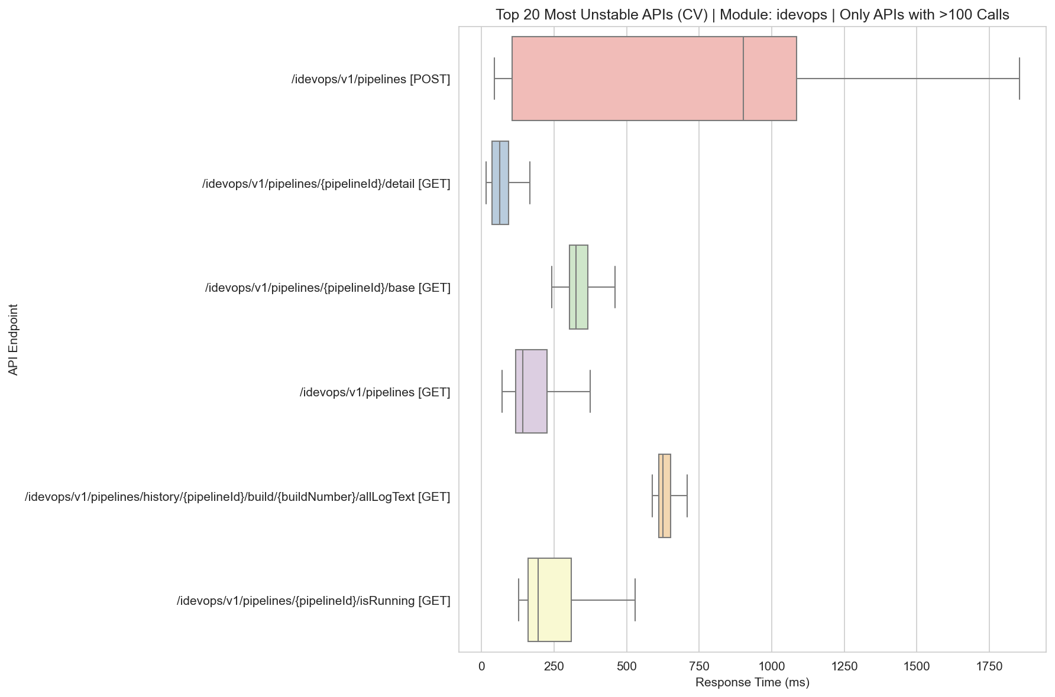
Unstable Boxplot Idevops

Slide 41
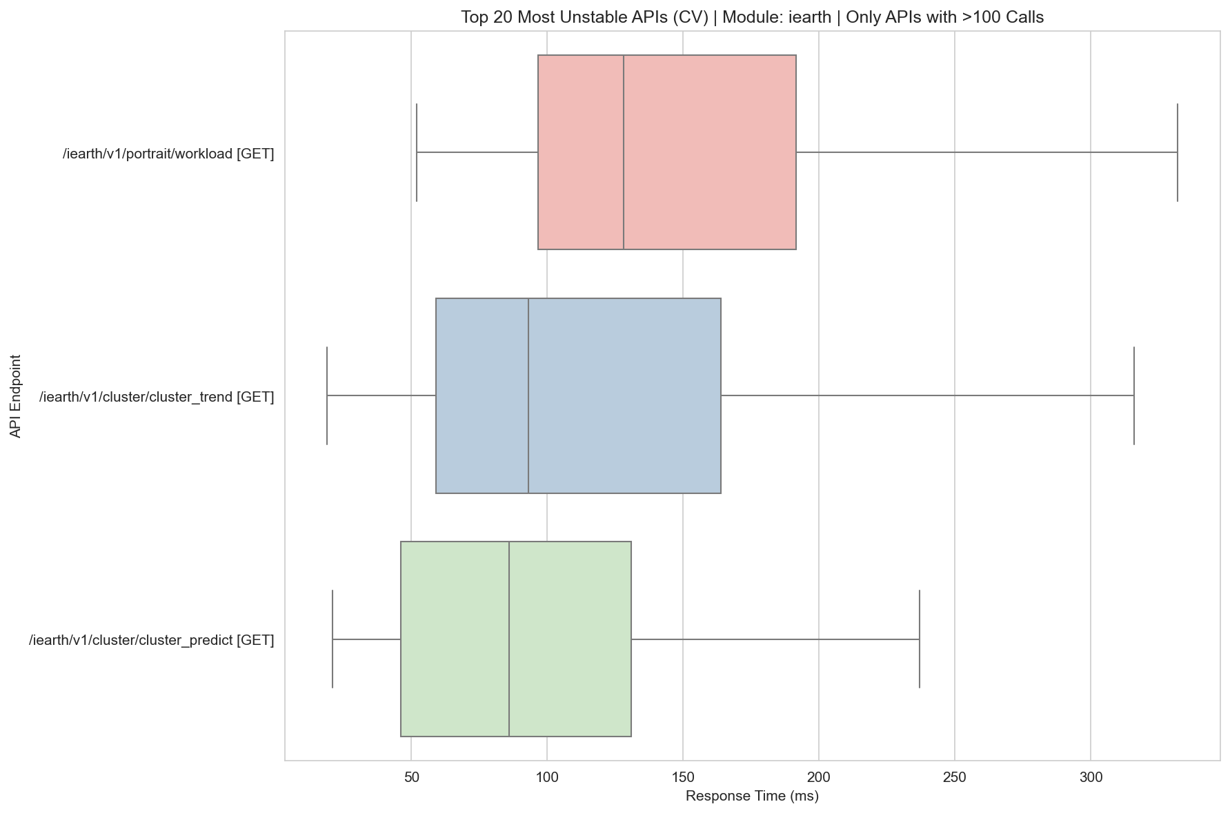
Unstable Boxplot Iearth

Slide 42
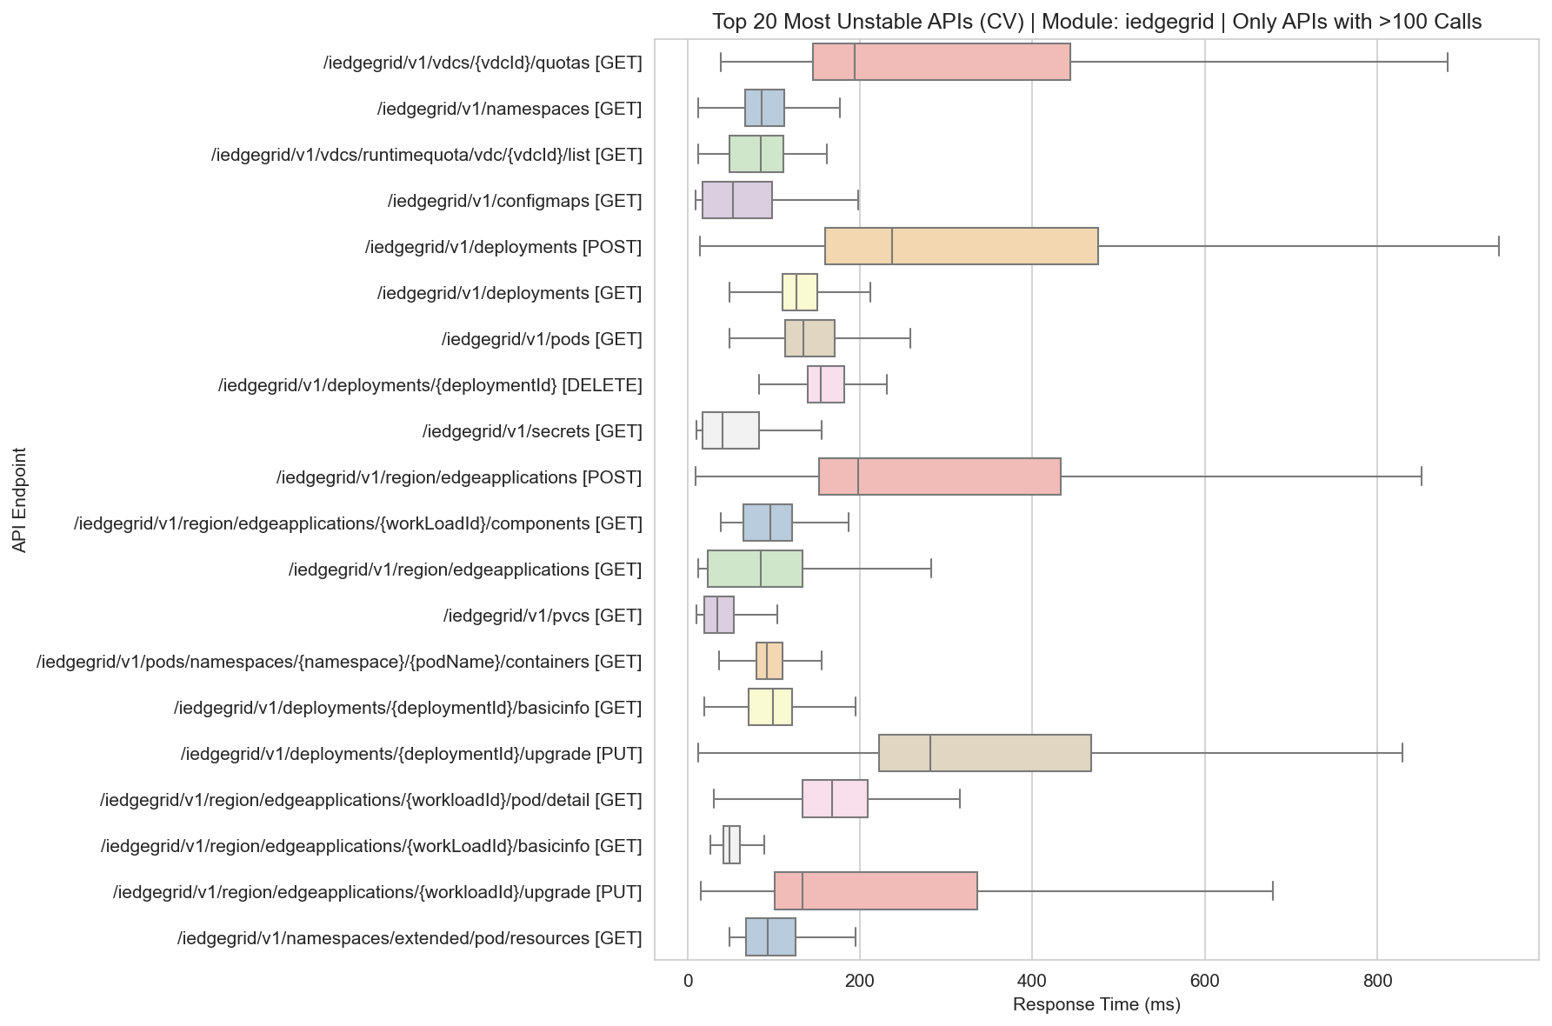
Unstable Boxplot Iedgegrid

Slide 43
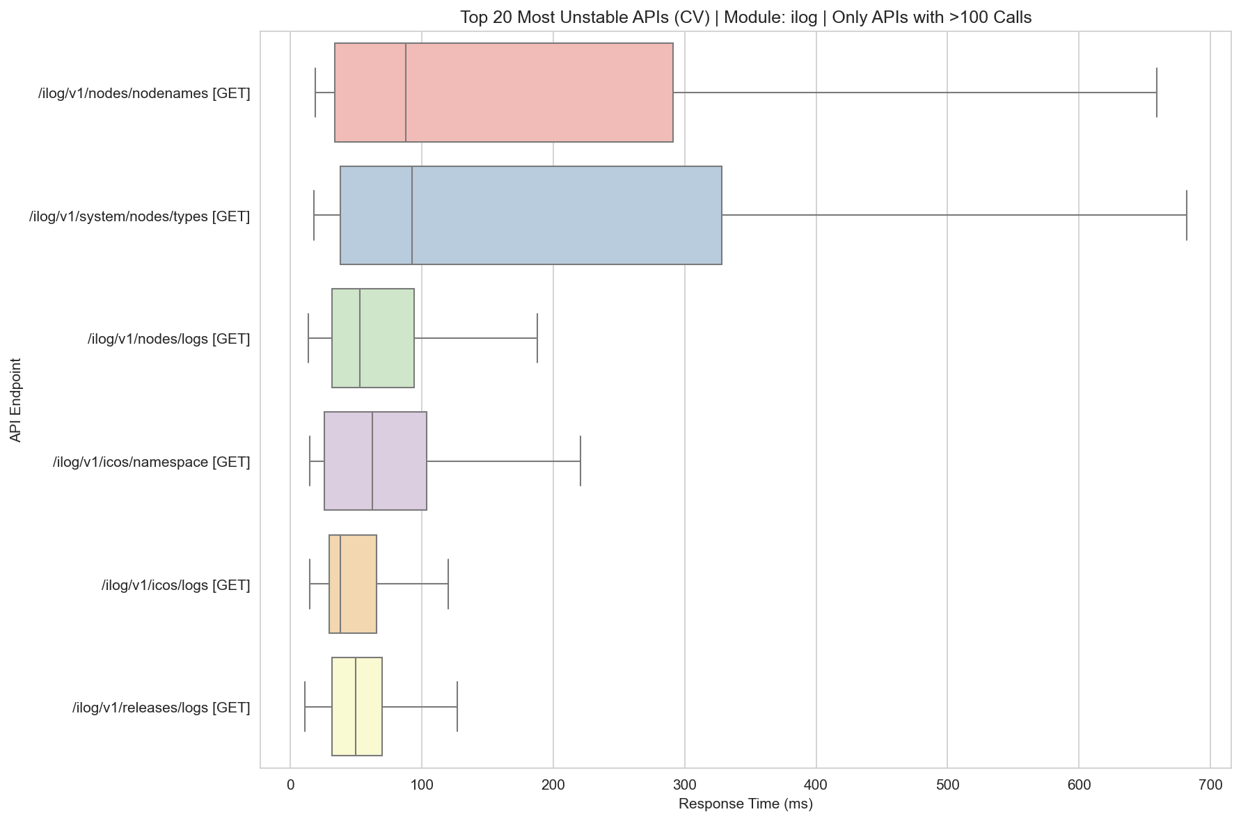
Unstable Boxplot Ilog

Slide 44
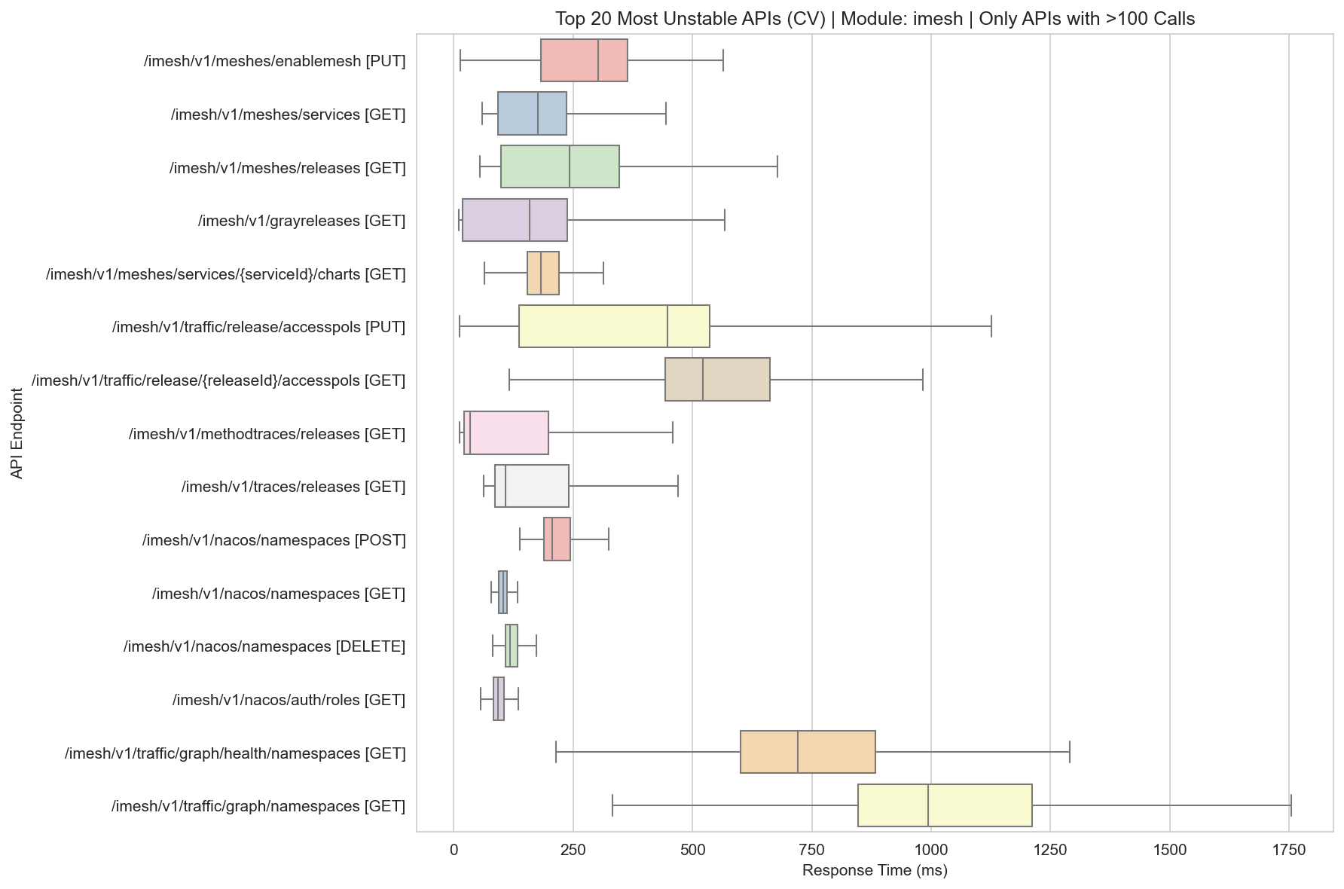
Unstable Boxplot Imesh

Slide 45
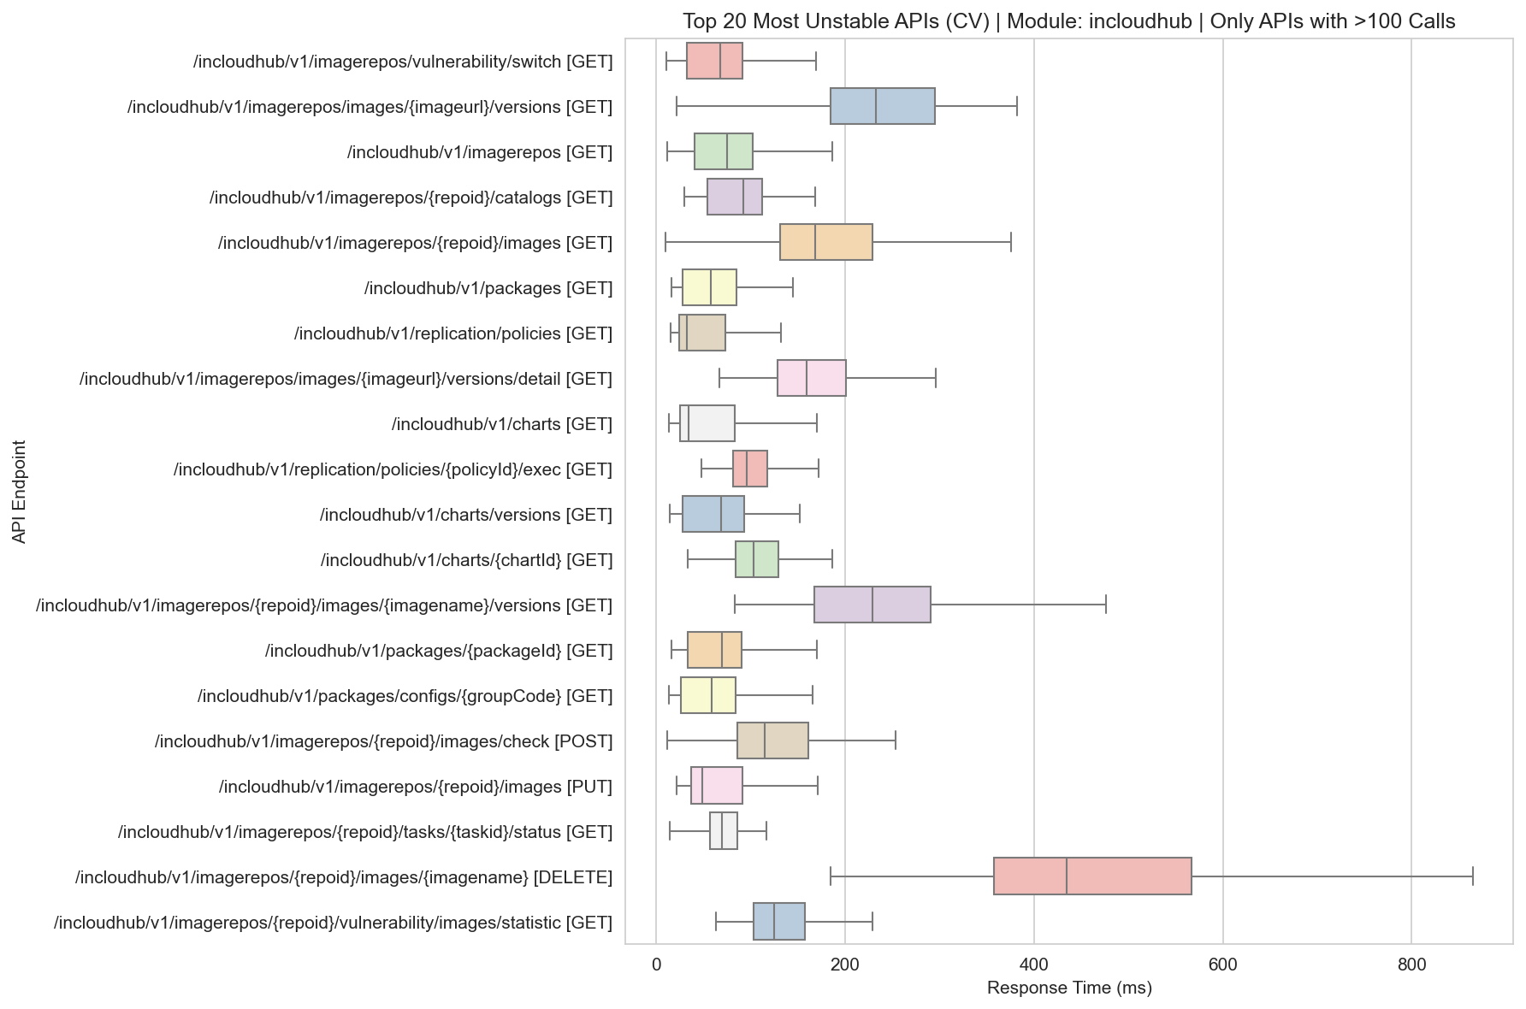
Unstable Boxplot Incloudhub

Slide 46
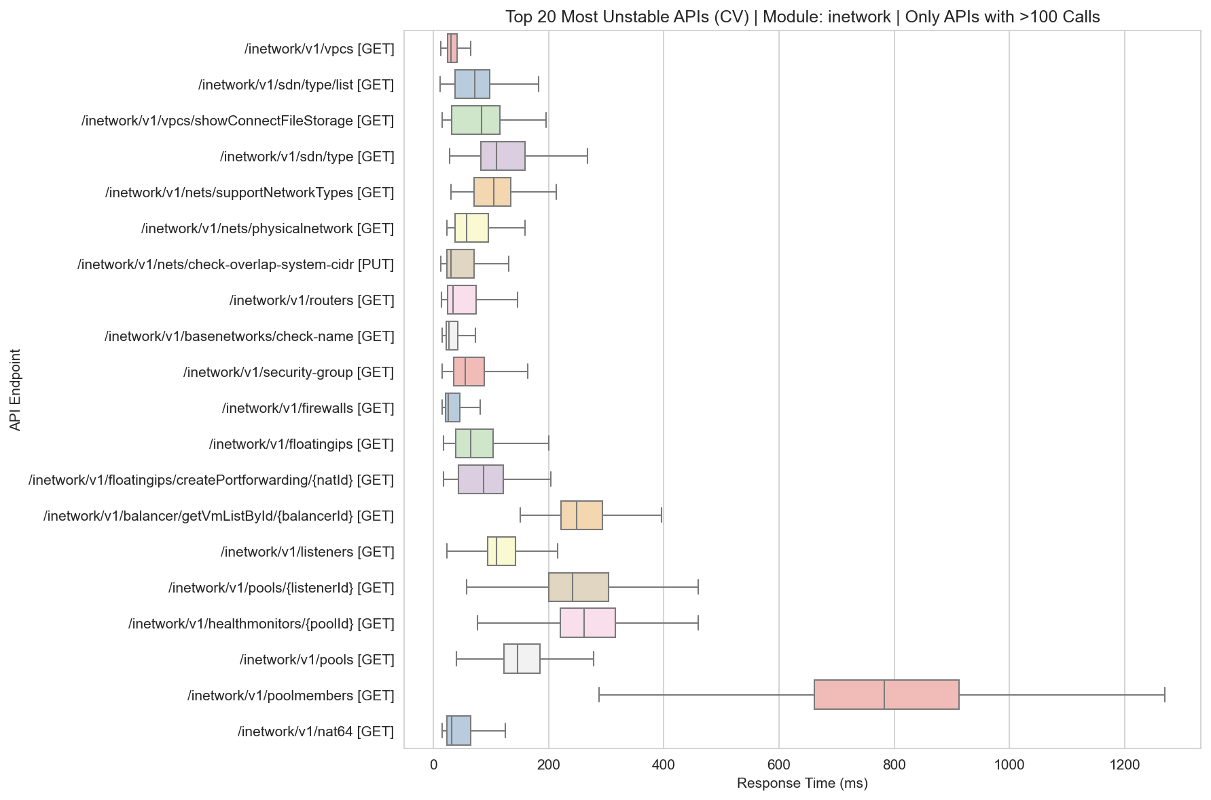
Unstable Boxplot Inetwork

Slide 47
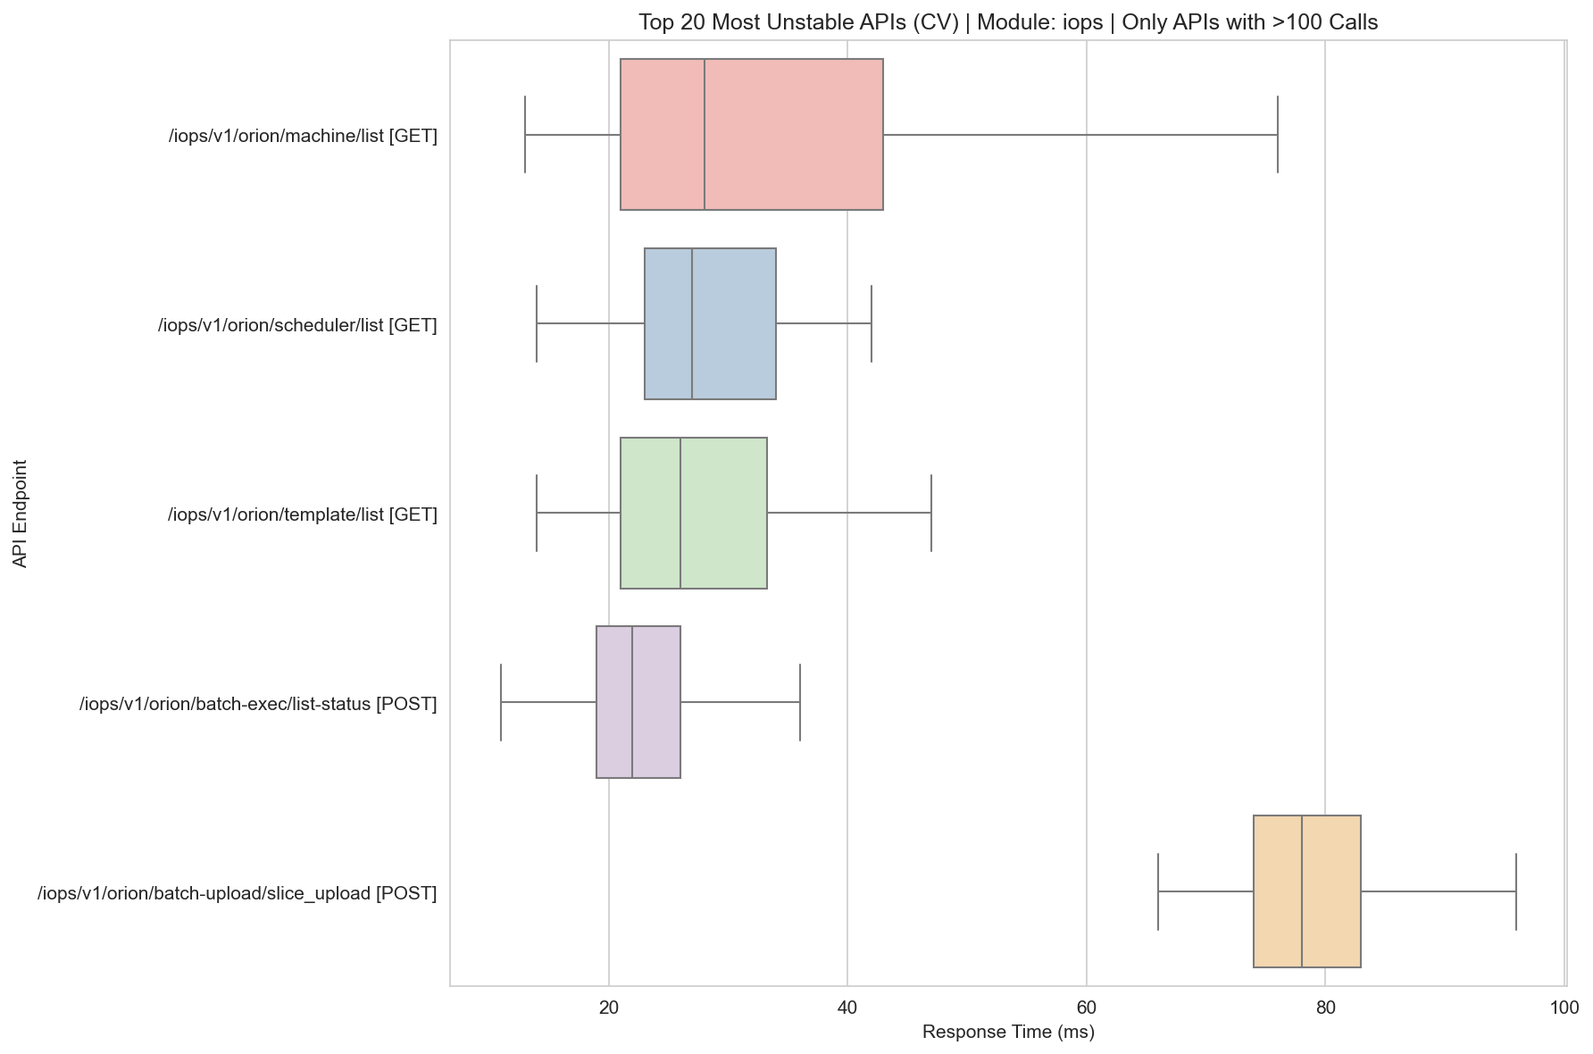
Unstable Boxplot Iops

Slide 48
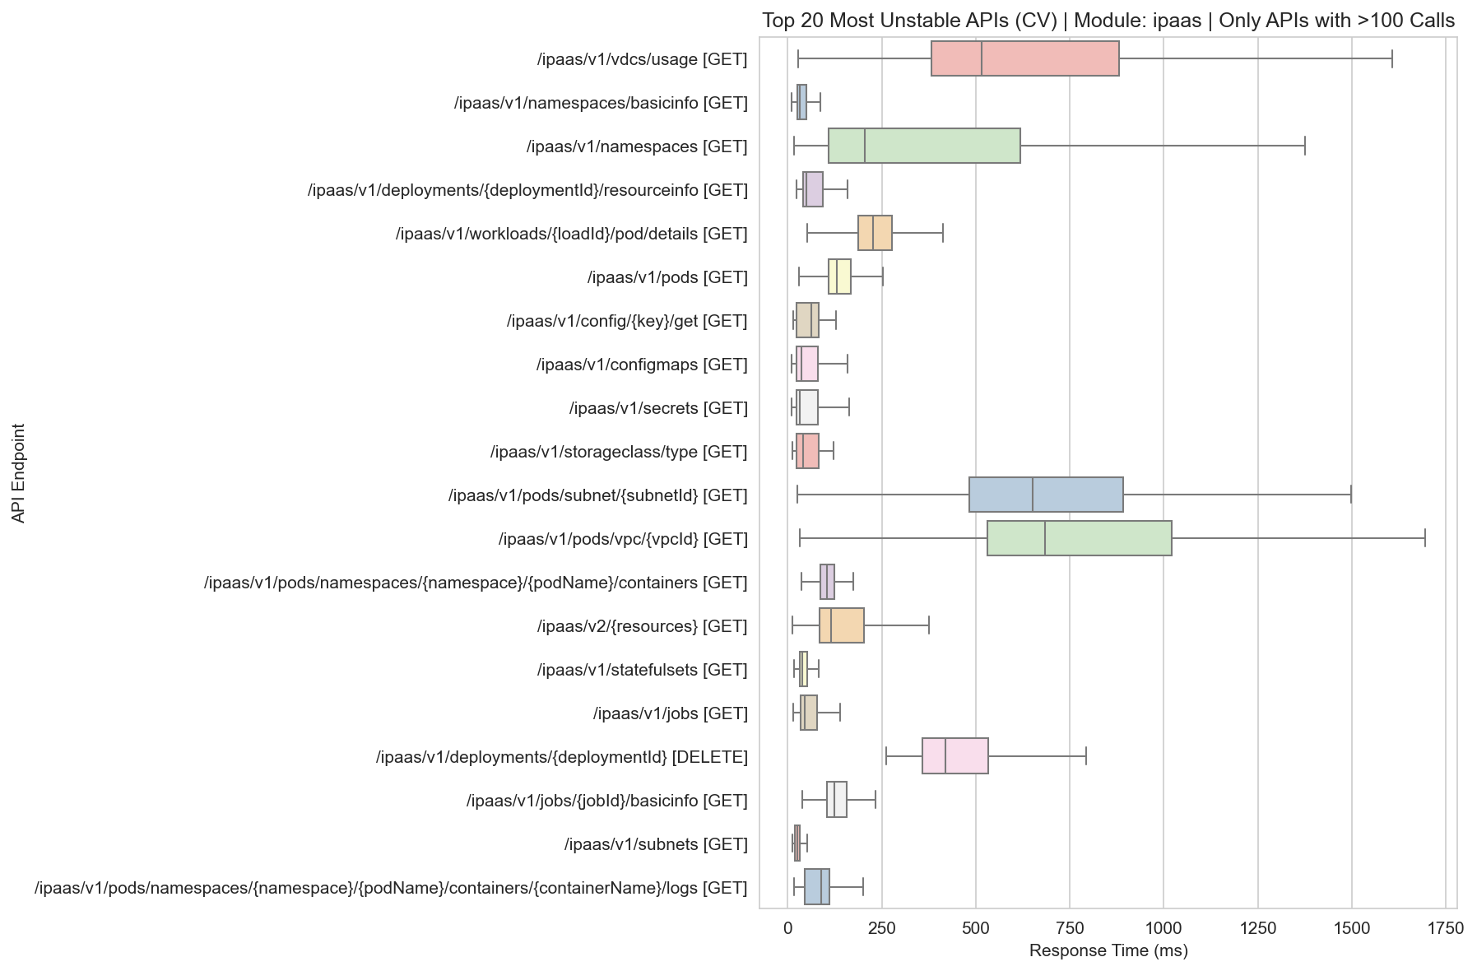
Unstable Boxplot Ipaas

Slide 49
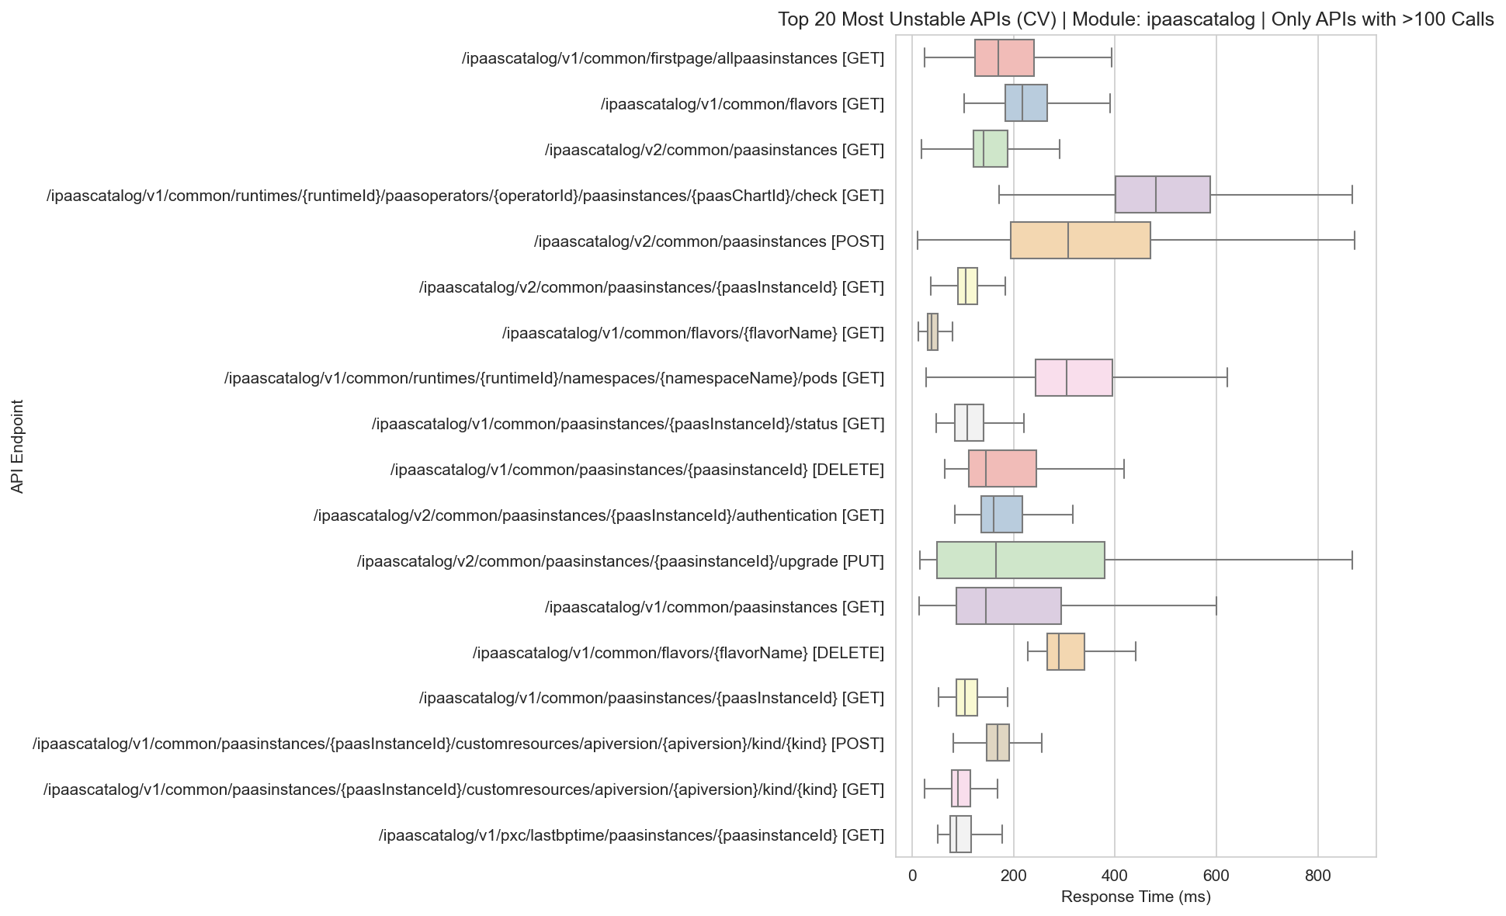
Unstable Boxplot Ipaascatalog

Slide 50
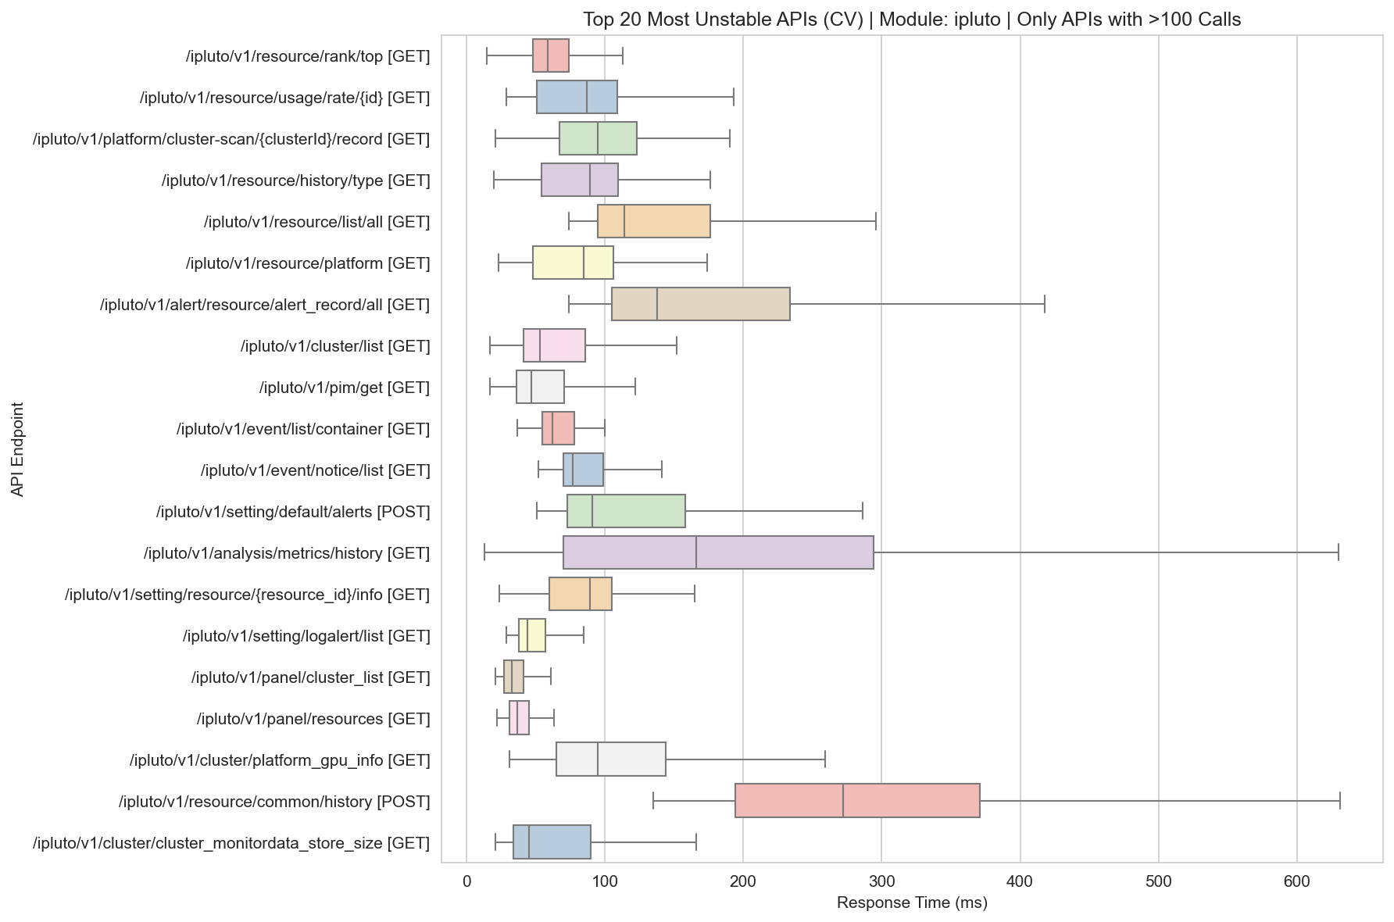
Unstable Boxplot Ipluto

Slide 51
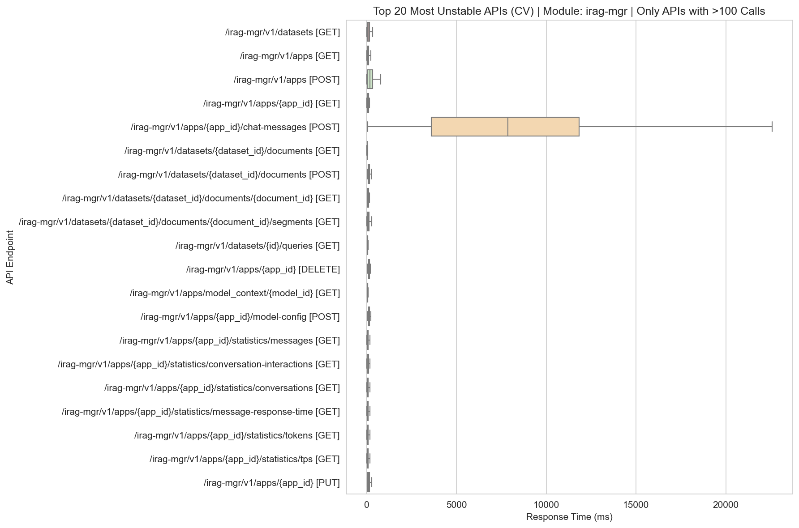
Unstable Boxplot Irag-Mgr

Slide 52

Unstable Boxplot Irecovery

Slide 53

Unstable Boxplot Ireport

Slide 54

Unstable Boxplot Iresource-Common

Slide 55

Unstable Boxplot Istellar

Slide 56

Unstable Boxplot Istorage

Slide 57

Unstable Boxplot Isync

Slide 58

Unstable Boxplot Itask

Slide 59

Unstable Boxplot Iunifycloud

Slide 60

Unstable Boxplot Iworkflow

